Slide 1

Home-Owned Robotic Arm
A desk-sized robotic arm designed to give users full control and demonstrate real-time operation
Group 10
Emanuel Alvarez
Hani Bdeir
Hailey Gorak
Jackson Jacques III
Nkunu Nuglozeh
Notes:
“Hello everyone, and welcome to Group 10’s, Home-Owned Robotic Arm, final presentation. Before we get started with the project, lets meet the team behind it all.”

Slide 2





Our Team Members:
Emanuel Alvarez:
Electrical Engineer
Hani Bdeir:
Computer Engineer
Hailey Gorak:
Computer Engineer
Jackson Jacques III:
Electrical Engineer
Nkunu Nuglozeh:
Electrical Engineer
Notes:
“These are our team members. They include: [list names in order]”

Slide 3
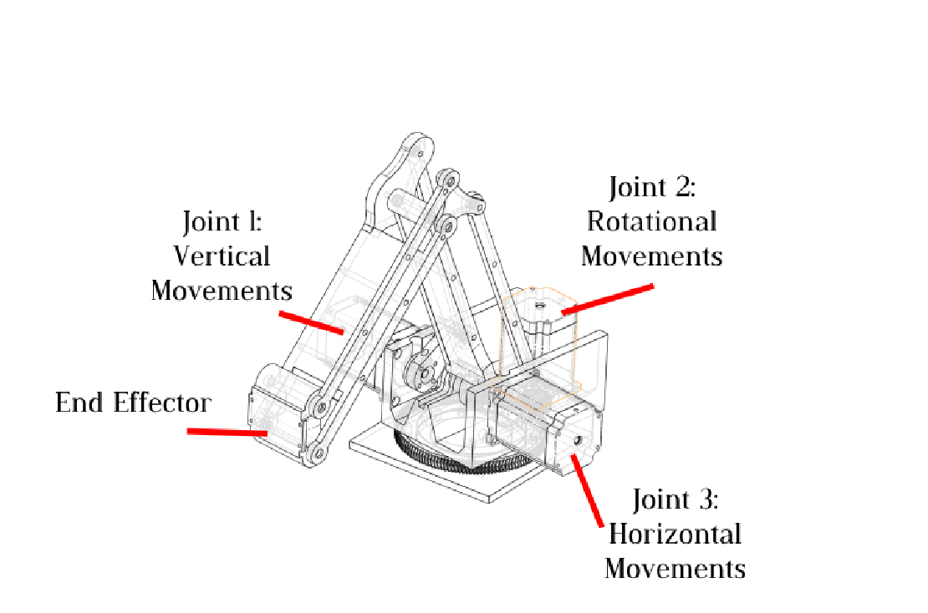
Motor Attachments

Slide 4

The Barriers to Robot Hardware
Robotics hardware is Very expensive
The Home-Owned Robotic Arm offers an affordable highly capable robotic platform. With a Bill of Materials (BOM) around $200 USD (excluding the optional PC or Raspberry Pi for simulation), it brings advanced robotics within reach for a much wider audience.
Notes:
“Force control is a prominent issue within industrial automation. Automated robots are designed to boost efficiency and accuracy across manufacturing lines, and they do this well! However, these machines still require human operators to work alongside them to ensure quality control. This human element poses a danger, since these robotic arms rarely have force control implemented. This means that if a robotic arm swings against or comes across a human operator in any way, there will most certainly be a major injury occurring. While this industry is not lacking in safety as a whole, this small feature could greatly reduce the number of fatalities among injuries. However, how do we implement something like this?

Slide 5
The Solution Without Compromise?
These shortcuts that most other designs take include :
Using Brushed DC Servos
Low accuracy and precision
No velocity control
Using High Gear Reductions
No backdrivability
Higher Cost
More Points of failure
Wears over time
Notes:
“Our solution is to use Field-Oriented Control. This gives us full control over torque, velocity, and force parameters of our robotic arm’s motors. This means that with the use of microcontrollers, embedded programming, and three-phase stepper motors, we can control the oscillation of our motors in a more precise and accurate manner than what the industry standard allows. Using these methods, we can also allow our robotic arm to adjust itself in real-time, and recognize when it has been obstructed, allowing it to reduce the amount of force it is using at a given time.”

Slide 6
Principles We Design Around
Elimination of Gear Reductions
Cost Savings: Direct drive with stepper motors removes the need for expensive gearboxes.
Reduced Complexity: Fewer components mean simpler assembly and less potential for mechanical failure.
Enhanced Reliability: Direct connection minimizes backlash and wear over time.
Utilization of Linkage Mechanisms
Ease of Manufacturing: Simplified design allows for straightforward production processes.
Scalability: Modular linkage components make customization and scaling efficient.
Benefits of Stepper Motors Over Brushed DC Servos
High Precision Control
Stepper motors offer excellent positioning accuracy without the need for feedback systems.
Improved Durability
No brushes mean less maintenance and longer motor life.
Energy Efficiency
Consumes power proportionally to the workload, leading to energy savings.
Notes:
“FOCUS stands for Field Oriented Control Utilization System, which is inspired by the way in which we are implementing field oriented control to improve our design. Our main motivation behind this implementation is the automation industry’s lack of sufficient safety precautions. By the addition of a simple force control algorithm, we could greatly improve the conditions that operators work in around these robotic devices. Let’s get more in depth about these issues.”

Slide 7
Goals & Objectives:
Achieve High Precision and Reliability in Automated Tasks
Advanced Sensing: Utilize rotary encoders as positional sensors for precise feedback.
Comprehensive Control: Implement precise position, velocity, and torque control.
Efficient Communication: Transmit all data through a CAN bus system for reliable and fast communication between components.
Additional Goals Include:
Tele-Operative Control
Operate robotic movement using a joystick device.
Features include emergency stop, record/replay functionality, and x/y/z-axis movement control.
Interactive End Effector
Equip the arm with a gripper or similar device to interact with objects, functioning like a hand.
Real-Time Positioning and Updates
Enable the robotic arm to detect and update its position precisely in real time.
Utilize the ROS (Robot Operating System) and Gazebo simulation environment for advanced control and visualization.

Slide 8
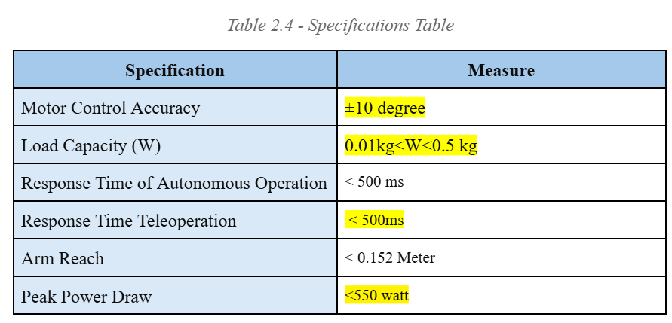
Engineering Requirements

Slide 9
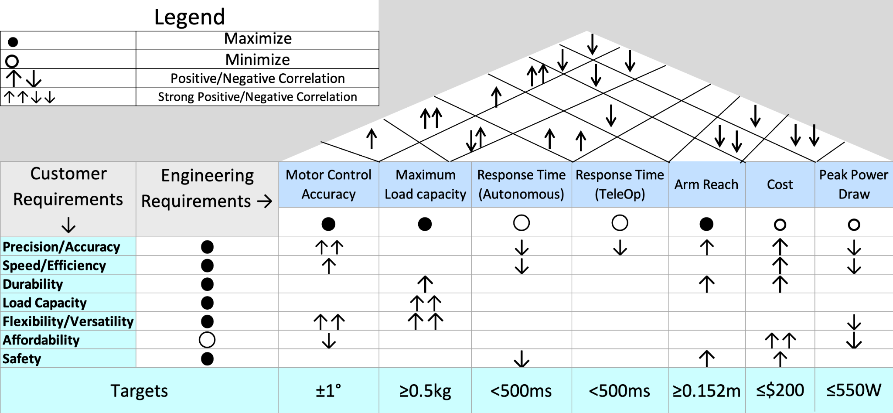
House of Quality
Notes:
The HOQ diagram was created to ensure that each engineering requirement aligned and supported the goals of our project.
The general purpose for this kind of diagram is to translate the customer needs and priorities into measurable targets, which guided us into making the right decisions on our robot arms design.
The measured targets are listed on the bottom of the diagram
There are several requirements that a customer would need for the robot arm such as a high level of precision & accuracy, durability, efficiency, and safety
There are many engineering requirements within our project such as the motor control accuracy, load capacity, response time, cost and peak power draw.
Comparing all of the factors from the engineering and customers sides, it can be seen how they all affect each other, which helped us make more informed choices on the selection of hardware and software components.
For example, according to the HOQ diagram shows the level of accuracy that the customer would want for their robot arm would have a strong positive correlation with the accuracy level of the robot arms’ motor control.

Slide 10

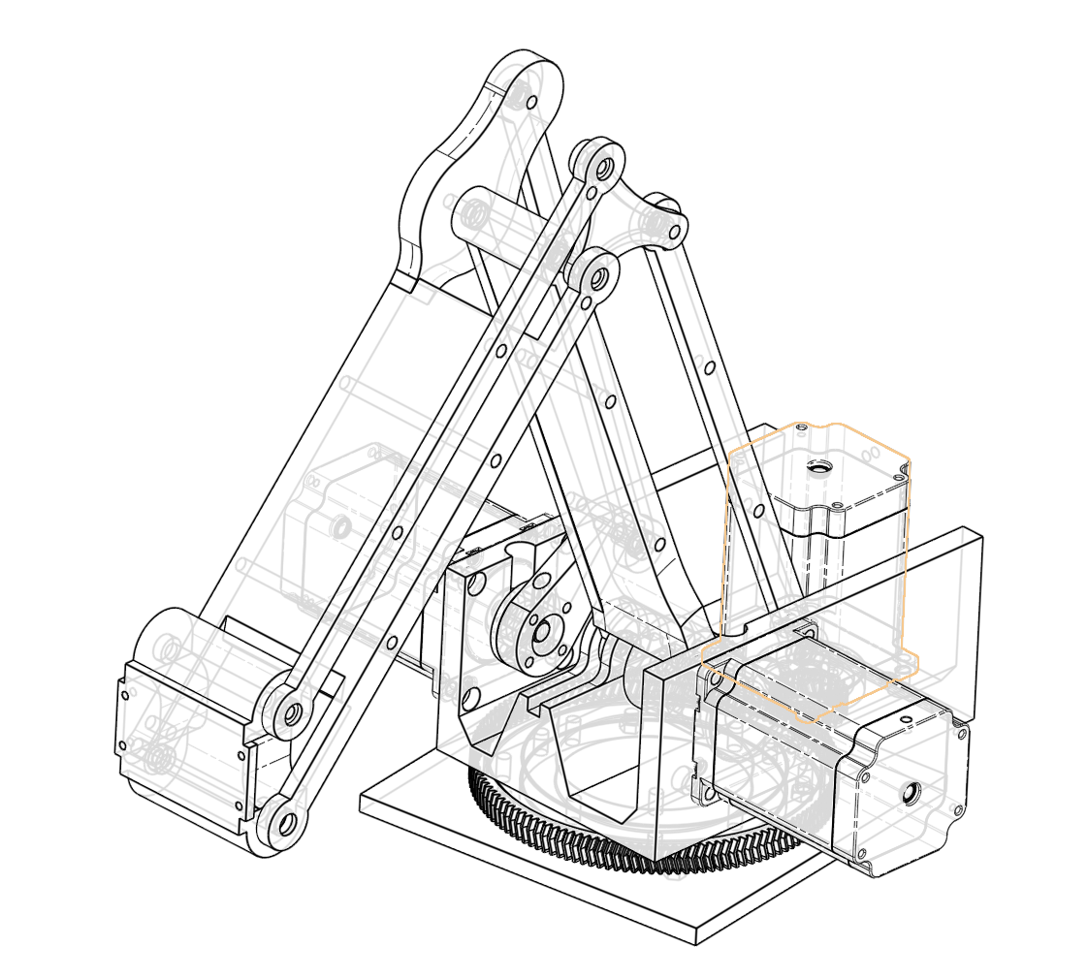
The Hardware:
CAD Model of Arm with Motors and End Effector
Notes:
Now let's dive into the hardware of our project and discuss how we put it all together.
As you can see from the image on the right, this involves a combination of electronic components and mechanical parts working seamlessly to control the robotic arm.
From the joysticks to the motor system, all the pieces of hardware are integrated to ensure smooth and precise control over the arm's movements.
In this section, We’ll take you through the individual components we chose, why we chose them, and who worked with them.

Slide 11
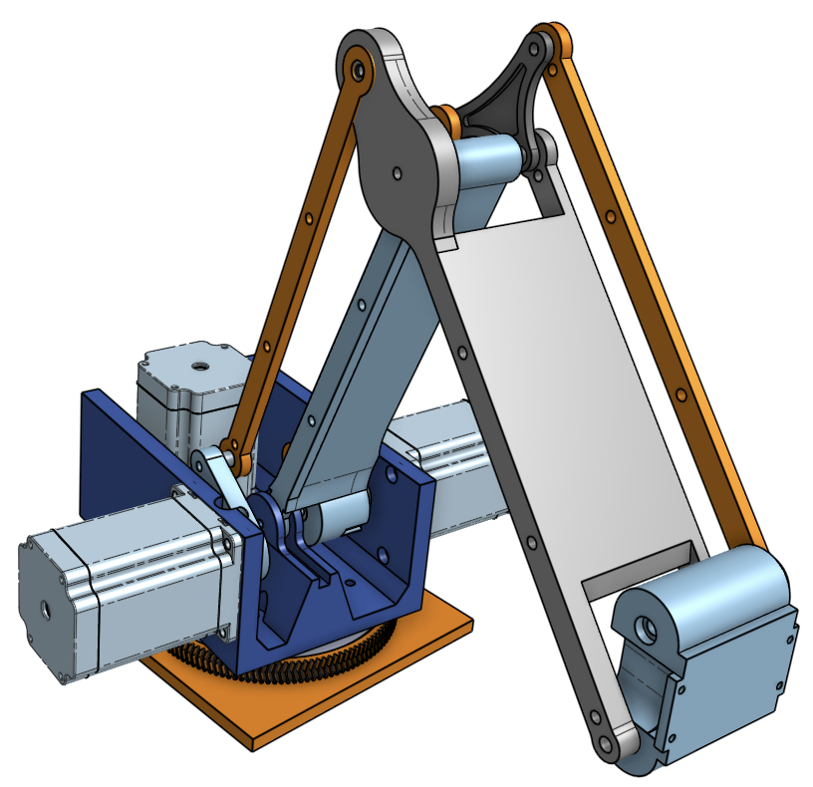
Mechanical Design: Conceptualizing it in 3D
We know the objectives, goals, and motivations of the project, how should the design look?
The design should be simple, generic enough to apply all the given requirements.
Using three joints, we can design a robotic arm with full mobility.
End effector should be and have its own actuator built in.
With all of this in mind, our team designed the 3D prototype of our project, pictured to the right.
3D Prototype of F.O.C.U.S. arm

Slide 12
Electrical / Computer Engineering Design
With the mechanical design complete, it's essential to address the electrical and computer engineering components to bring the robotic arm to life:
Microcontroller
Serves as the central processing unit, executing control algorithms and managing system operations.
Motor Controller
Precisely regulates the stepper motors for accurate movement and positioning.
Position Sensors
Provide real-time feedback to ensure precise control and detect any deviations.
Primary Communication Bus
Utilizes a CAN bus system to ensure efficient and reliable data transmission between all components.
Joystick Interface
Enables intuitive tele-operative control for the user, including movement and emergency stop functions.
Power Electronics
Supplies stable and efficient power to all electronic components, ensuring reliable performance.
We will explain our design decisions for each of these elements to optimize functionality and integration.

Slide 13
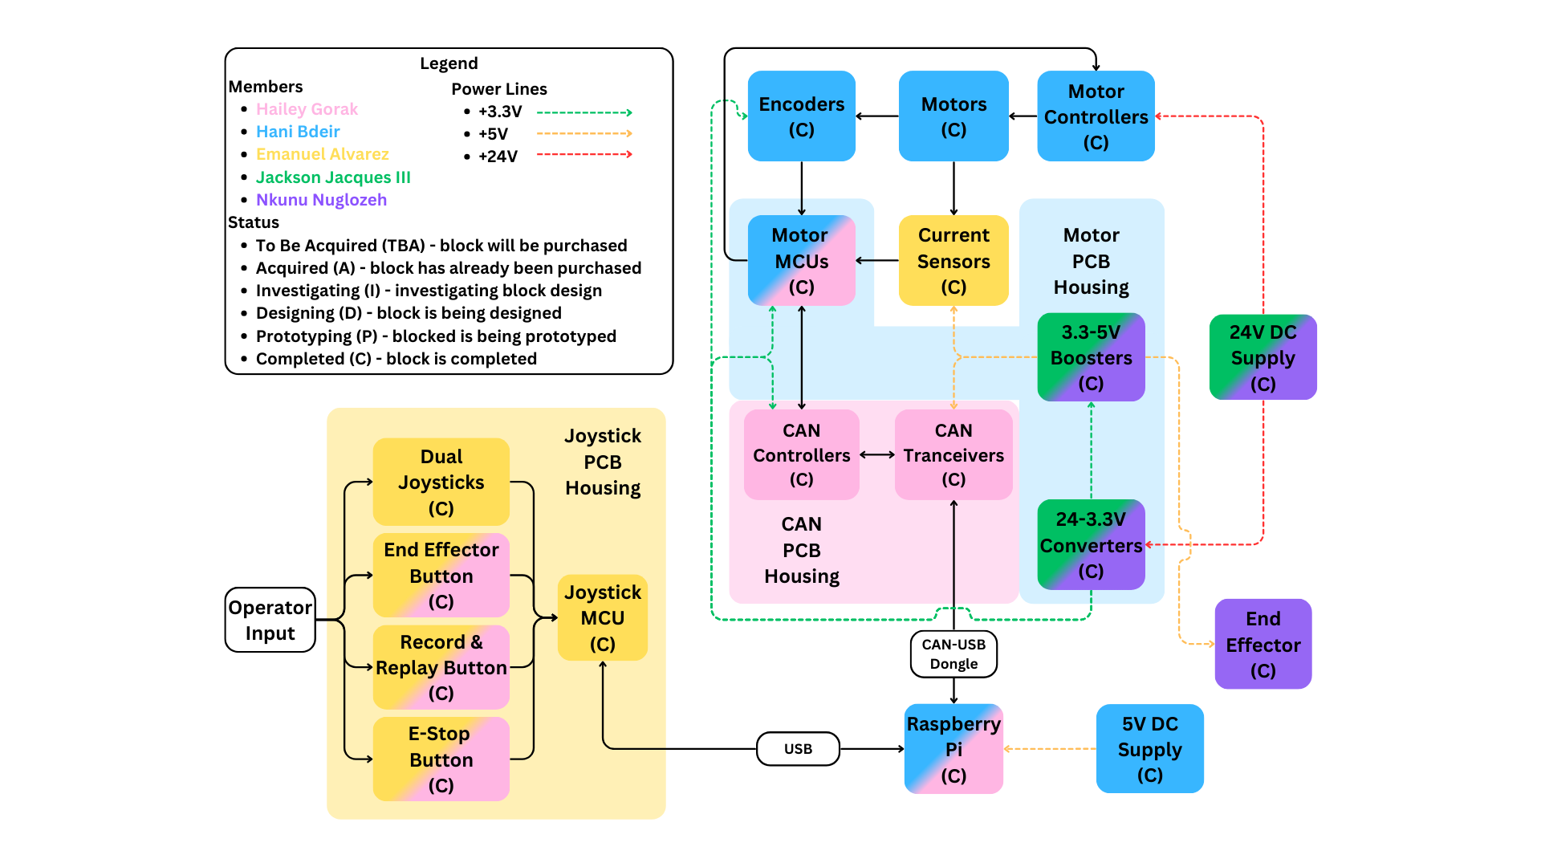
Hardware Block Diagram
Notes:
The hardware design integrates multiple systems to control the robotic arm.
At the core are three ESP32 microcontrollers, each controlling a stepper motor and its peripherals, such as a current sensor and encoder and motor controller.
With one handling the end effector servo.
Communication is handled through a CAN bus system, enabling efficient and reliable data transfer between all microcontrollers and the Raspberry Pi.
The Raspberry Pi acts as the main controller, processing joystick and button inputs, and sending commands to the motor nodes.
Power is supplied via a 24V switching power supply, with buck and boost regulators stepping voltages down or up as needed to support each component.
I, Emanuel designed the joystick PCB and current sensors and was responsible for their implementation and integration.
Hani designed the MCU PCB, handled motor control, encoder integration, and managed the Raspberry Pi setup.
Hailey developed the CAN bus PCB, ensuring smooth communication between all hardware nodes.
Jackson and Nkunu handled the voltage regulators and the overall power distribution system, ensuring stable and efficient power for the entire setup.

Slide 14
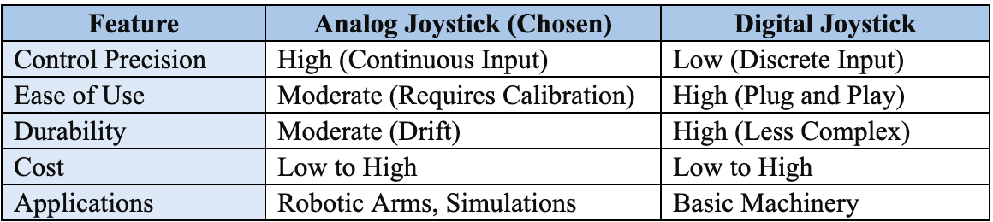
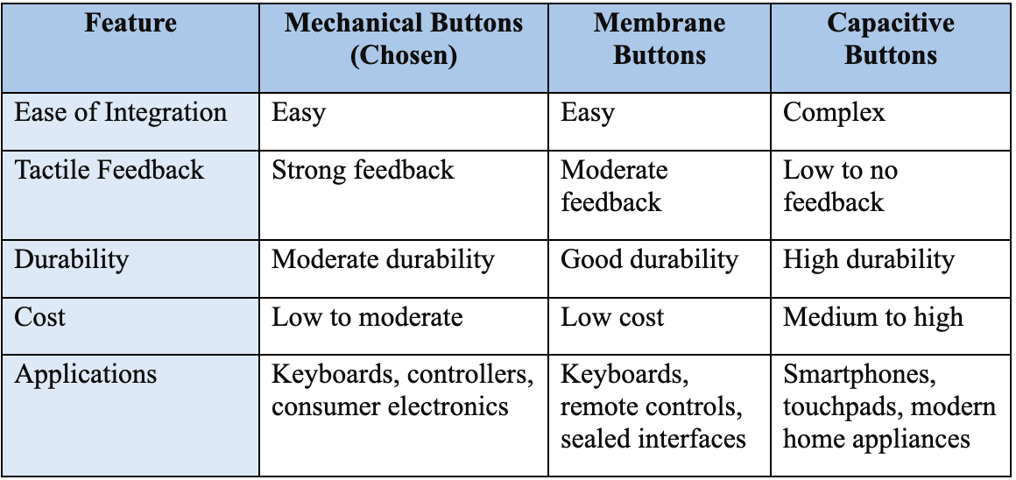
Joystick PCB Component Comparisons
Analog Joystick Chosen: High precision and continuous input for smooth robotic arm control.
Mechanical Buttons Chosen: Strong tactile feedback and easy integration.
Durability: Moderate durability for both joystick and buttons at a reasonable cost.
Applications: Analog joystick and mechanical buttons ideal for robotics and simulations.
Notes:
For the joystick subsystem, we evaluated different options for both the joystick and buttons.
We chose an analog joystick with a potentiometer-based mechanism.
The potentiometer-based design was selected for its accessibility, simplicity, and positive user reviews compared to that of the Hall Effect equivalent, making it ideal for our application which needs reliability.
Analog joysticks provide continuous input, enabling smooth and accurate control of the robotic arms movement, especially for fine motor tasks.
In contrast, digital joysticks only offer discrete input, which wouldn’t deliver the same level of precision.
For the buttons, we selected mechanical buttons due to their strong tactile feedback and ease of integration.
While membrane and capacitive buttons have advantages like durability and modern applications, mechanical buttons were better suited for our use case, where clear, reliable feedback is needed for safety functions like the emergency stop button.
Additionally, their durability and low cost made them a practical choice for our design.

Slide 15
Joystick PCB Microcontroller Comparison
Microcontroller | ATmega328P | ATmega32U4 | ESP32
Clock Speed | 16 MHz | 16 MHz | Up to 240 MHz
Flash Memory | 32 KB | 32 KB | Up to 4 MB
RAM | 2 KB | 2.5 KB | 520 KB
Connectivity | UART, I2C, and SPI | UART, I2C, SPI, and native USB with HID support | UART, I2C, SPI, Wi-Fi, and Bluetooth
Package | DIP socket or SMD | SMD | SMD
GPIO Pins | 23 | 26 | 36
Ease of Programming | Simple with Arduino IDE | Challenging to boot, but easy afterwards | Simple with Arduino IDE
Cost | Low | Moderate | Moderate
Considered three microcontrollers: ATmega328P, ATmega32U4, and ESP32.
Chose ATmega32U4 for its native USB HID support, simplifying communication with the Raspi
ATmega32U4 has enough GPIO pins, moderate cost, but is harder to boot and smaller to solder.
ATmega328P is super easy to use (DIP package) but lacked necessary features.
ESP32 is overpowered for our needs, with Wi-Fi, Bluetooth, and more memory, but lacks HID.
Notes:
We considered three microcontrollers for the joystick PCB: the ATmega328P, the ATmega32U4, and the ESP32.
The ATmega32U4 was chosen primarily for its native USB HID support, which simplifies communication with the Raspberry Pi, a critical feature for our joystick’s functionality.
It struck the perfect balance with enough GPIO pins for our design and good pricing, making it a practical choice.
The ATmega328P is incredibly easy to work with due to its DIP package, making it beginner-friendly and simple to solder. However, it lacked the advanced features we needed, so we didn’t use it.
The ESP32 offers significant performance advantages, such as Wi-Fi, Bluetooth, and higher memory capacity. However, these capabilities were excessive for our design requirements and it didn’t have HID functionality anyways.
While it’s technically harder to boot and has a smaller SMD package compared to the other two the ATmega32U4s HID support outweighed these challenges, making it the ideal fit for the joystick PCB.

Slide 16
Motor Type Selection
After careful evaluation of various motor options, we have selected the most suitable type for our robotic arm project. The key factors considered were performance, efficiency, cost, and the specific requirements of our design. Among the three types reviewed—Brushed DC Motors, BLDC Motors, and Stepper Motors—we chose the option that best aligns with our need for precise positioning, high torque at low speeds, and cost-effectiveness.
Motor Types Considered:
Brushed DC Motors: Simple, low-cost, but requires maintenance and has lower efficiency.
BLDC Motors: High efficiency and performance, but complex and costly to control.
Stepper Motors: Precise positioning, high torque at low speeds, and cost-effective, but less efficient at high speeds.
Final Choice: Stepper Motors
Why Stepper Motors?
Ideal for precise positioning and high torque at low speeds, aligning with our project’s needs.
Offers simple control without requiring complex feedback systems.
Provides steady holding torque, crucial for maintaining positions.
Stepper motors strike the best balance between performance, cost, and the project’s constraints on volume, complexity, and budget.

Slide 17
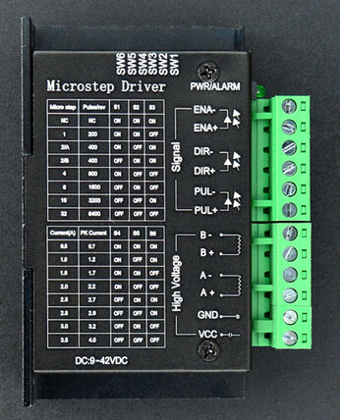
Motor Controller Selection
1. Compatibility with NEMA 23 Stepper Motors:
Handles 24v @ 4.5amps
2. Microstepping Precision:
Microstepping up to 1/32th of a step
3. Ease of Integration:
step/dir control signals,
4. Robustness and Safety:
Built-in over-voltage, over-current, and over-temperature protection.
5. Cost-Effectiveness:
9.99USD
TB6600 Motor Controller

Slide 18

End Effector Technologies
Technology | Vacuum Gripper | Parallel Gripper | Angular Gripper | Electromagnetic Gripper
Strengths | Objects can be quickly picked up or released. Best grip on smooth, flat objects | Predictable grip and interaction with objects Larger surface area in contact with target | Accommodates a wider range of object sizes in grip | Objects can be quickly picked up and released Can best handle objects of irregular shapes
Weaknesses | Needs to be powered to maintain grip Difficulty handling rough or irregularly shaped objects | Difficulty with irregularly shaped objects | Less surface area in contact with target Potential for instability | Can only handle magnetic materials Attracts any nearby metallic object not just the intended target
Applications | Smooth and/or delicate objects like glass panes | Diversity of object shapes and textures | Diversity of object shapes and textures | Diversity of magnetic materials
Notes:
Presented here are a few end effector technologies we researched for implementation in the robotic arm. Those being, vacuum grippers which operate using a powered suction cup, parallel grippers which use a claw that opens and closes with the tines remaining parallel to each other, angular grippers which are similar but open and close at an angle into a pinching motion, and electromagnetic grippers which use an electromagnet to attract objects and manipulate them. In the table are some strengths and weaknesses. Vacuum grippers excel with smooth delicate objects like glass panes, but aren’t broadly applicable so many different types of objects, while Electromagnetic grippers are the best at handling objects of unusual shapes but can only handle specific materials. Ultimately we narrowed it down to parallel and angular grippers with parallel grippers being chosen due to the larger surface area of contact improving the predictability of the grip.

Slide 19
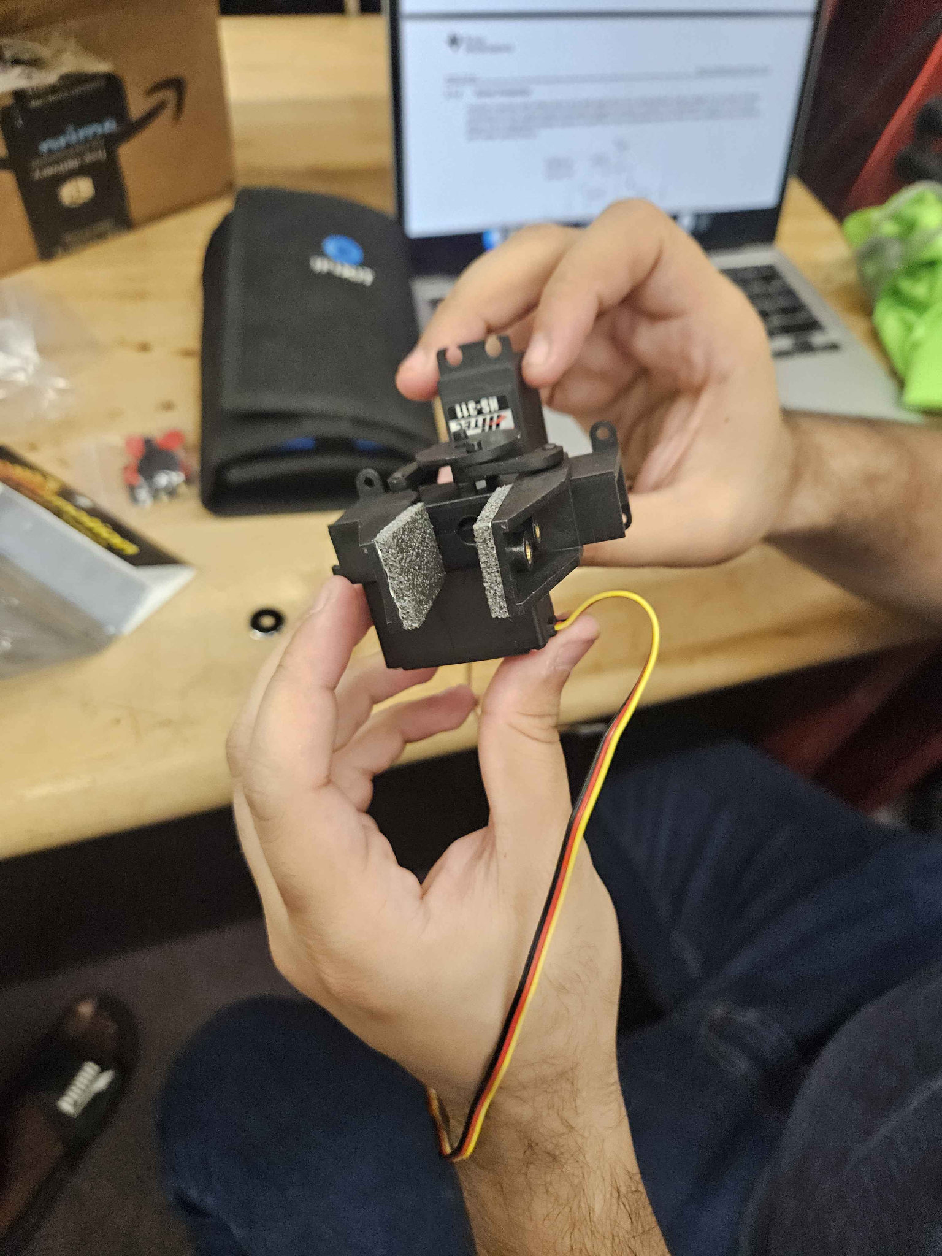
Our Chosen End Effector: Parallel Gripper
Technology | LG-NS Robot Gripper | Robot Gripper
Size | 57x65x30 mm | 05x100x30mm
Grip Width | 0-33mm | 0-54mm
Price | $16.00 | $9.00
Operation | 1 motor | 2 motors
Notes:
On the slide here we have a comparison between two parallel grippers in consideration both from the same supplier. While the right column has a wider grip width, ultimately the left column was chosen due to having a larger surface area inside its gripper and only using one motor which simplifies implementation at the end of the robotic arm.

Slide 20
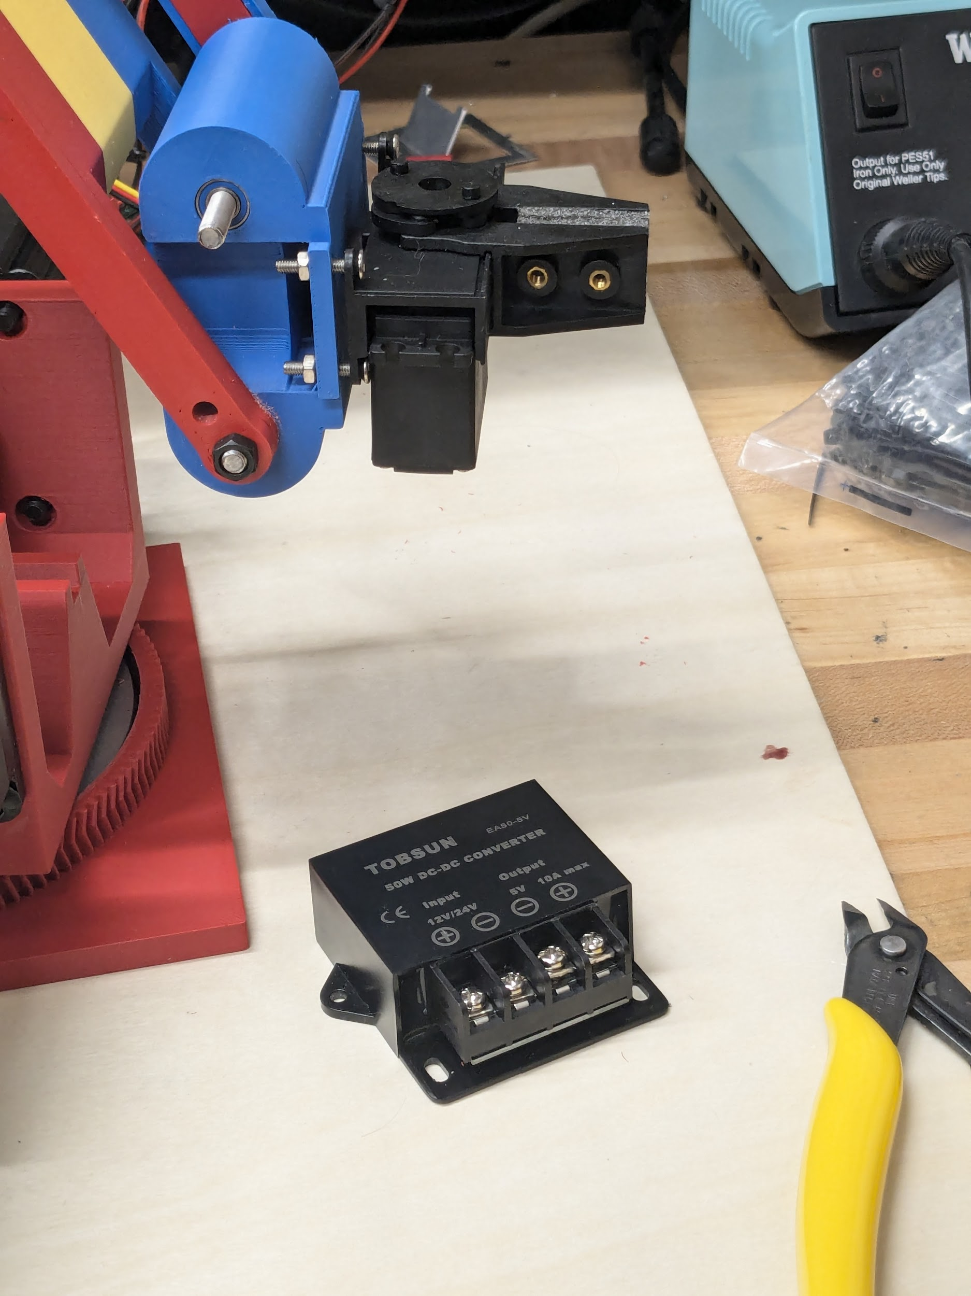
LG-NS Robot Gripper
The chosen end effector is an LG-NS parallel gripper
Max clamp width: 1.3 inches
Weight: 25 grams
Cushioned clamps
The gripper is operated by an HS-311 servo.
Operating voltage: 5V
Running current: 160mA
Stall current: 700mA
The servo is powered by a VOLRANTISE 24 to 5V buck converter capable of supplying up to 5 amps at 5V and connected to the analog output of the MCU
Gripper with attached servo and converter
Notes:
On this slide we have more details about the selected gripper and our integration of it. Some additional advantages this gripper provides are low weight and cushioned clamps. As you can see it’s placed on a custom 3D printed mount with an HS-311 servo. The servo is powered by a volrantise 24 to 5 volt buck converter and it is controlled through the analog output pin on the microcontroller. The gripper is toggled open and closed by pressing a button on the joystick PCB.

Slide 21
Position Sensors
Factors such as measurement accuracy, resolution, environmental robustness, and cost all play significant roles in determining the most suitable sensors for our needs. We conducted a comprehensive analysis of each sensor type, considering not only their individual specifications but also how they align with our project's unique requirements and constraints.
We ultimately selected the AS5600 encoder as it was the best value for the price and fit our needs.
Feature | CUI - AMT10 | REV Through Bore Encoder | AS5600
Type | Through Bore | Through Bore | On shaft
Resolution (CPR) | 8192 | 8192 | 4096
Accuracy (deg) | 0.0127 | 0.01 | 0.04
Max RPM | 7500 | 10000 | 60000
Price | $24.00 | $35.00 | $5.10

Slide 22
Current Sensors Technology Comparisons
Feature | Hall Effect (Chosen) | Shunt Resistors | Rogowski Coil | Current Transformer
Circuit Isolation | Yes | No | Yes | Yes
Accuracy | Moderate to High | High | Moderate | High
Bandwidth | Low to Moderate | High | High | Moderate
Power Dissipation | Minimal | High | None | None
Ease of Integration | Moderate | Easy | Moderate | Moderate
Response Time | Fast (µs range) | Very Fast (ns-µs range) | Very Fast (ns range) | Moderate (µs-ms range)
Cost | Low to Moderate | Low | High | Moderate to High
Notes:
We evaluated four current sensing technologies: Hall Effect sensors, shunt resistors, Rogowski coils, and current transformers.
We ultimately chose Hall Effect sensors due to their circuit isolation along with their minimal power dissipation and fast response time in the microsecond range.
Shunt resistors were another option, offering high accuracy and bandwidth, but they lack circuit isolation and dissipate more power, which didn’t align with our design goals.
Rogowski coils provide high bandwidth and very fast response times, but they’re less accurate and significantly more expensive, making them less practical for our application.
Current transformers are a cost-effective choice with circuit isolation, but they offer only moderate bandwidth and slower response times compared to the other technologies.
The Hall Effect sensor struck the perfect balance for our needs, combining moderate-to-high accuracy, reasonable ease of integration, and a low-to-moderate cost, making it perfect for our current sensing subsystem.

Slide 23
Current Sensors IC Comparison
Feature | Allegro ACS712-05B (Chosen) | Texas Instruments TMCS1101 | LEM LA 25-NP
Current Range | ≤ 5 A | ≤ 20 A | ≤ 25 A
Sensitivity | 185 mV/A | 100 mV/A | 250 mV/A
Response Time | 5 μs | 6.5 μs | 1 μs
Form Factor | Surface Mount | Surface Mount | Through-hole
Cost | $5.69 | $6.59 | $34.21
Seller | DigiKey | DigiKey | DigiKey
Notes:
We compared three current sensor ICs: the Allegro ACS712-05B, Texas Instruments TMCS1101, and LEM LA 25-NP, focusing on current range, sensitivity, response time, and cost.
The Allegro ACS712-05B was chosen because it meets our current range requirement of up to 5 A, with a good sensitivity of 185 mV/A, making it ideal for precise low-current measurements.
Its 5 µs response time ensures fast current sensing for real-time control applications.
The Texas Instruments TMCS1101 supports a wider current range of 20 A but has a slower response time of 6.5 µs, which made it less appealing for our real-time needs.
The LEM LA 25-NP offers the best response time of 1 µs and handles up to 25 A, but its through-hole form factor and high cost of $34.21 made it unsuitable for our compact and budget-conscious design.
The ACS712-05B also stood out for its low cost of $5.69, available through DigiKey, and its surface mount form factor, which aligns with our PCB design constraints.
Overall, it provided the best balance of performance, cost, and form factor, making it the optimal choice for our project.

Slide 24

Microcontrollers: ESP32’s
Our chosen microcontrollers, the ESP32’s are capable of driving our motor controllers, processing current sensor and encoder data, as well as taking in information from our computer in regards to joystick data.
Takes in data from encoders and sensors and sends it over a communication line to our computer
Takes in joystick input from computer to send to motors, which drives our robotic arm.
There are three microcontrollers, one for each motor, which handles all peripheral devices and communication nodes attached to its particular node.
These act as the basis of our motor, encoder, and current sensor operation. They are able to handle many functions at once, as well as real-time operation.
Notes:
Microcontrollers of any project are used to be the main drivers of the hardware. For our project, we chose to use the ESP32 microcontrollers. These devices are tiny, but powerful. Their purpose is to take in all data from our encoders to read the angle of our motors, the current sensor to read current spikes, and send this data to our raspberry pi computer. They also take in data from our computer, allowing our joysticks to directly drive our motors. These powerful processing tools give us the ability to implement many other functions, such as the emergency stop and record and replay functionality, which will be talked about further in the software section.

Slide 25
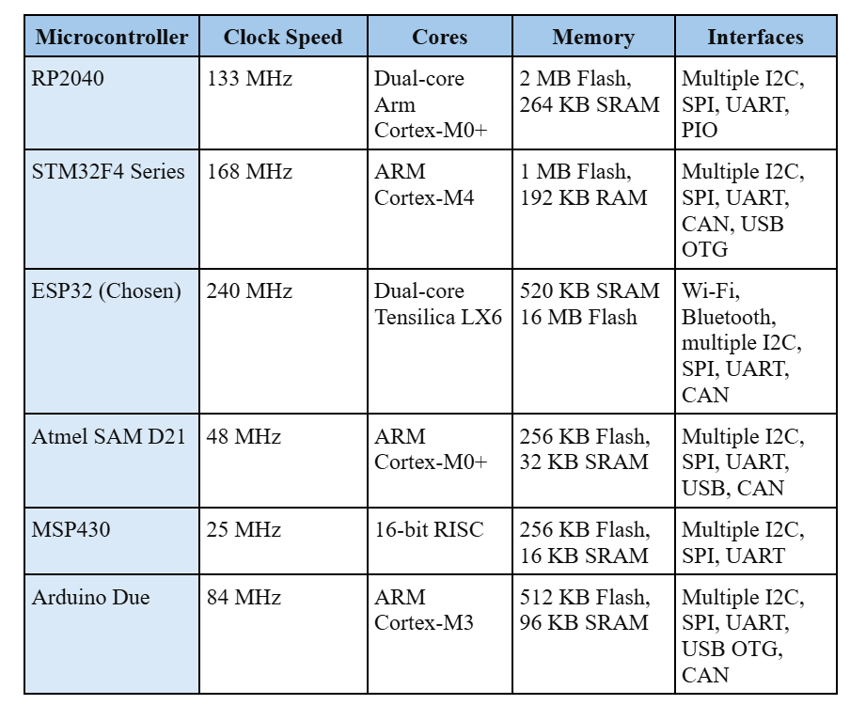
Microcontroller Comparisons:
With many microcontrollers to choose from, our reasons for choosing the ESP32s are as follows:
Clock Speed: Can use up to 240 MHz for running code, making these incredibly efficient.
Cores: Dual-core system allows us to use multithreading, making processing data parallel rather than the slower serial.
Memory: Far more memory than other models, however less memory than some, keeping this module economically efficient.
Interfaces: Is compatible with a majority of communication systems buses.
Overall: Capable of handling large mathematical operations. Has a large amount of documentation to reference for code, troubleshooting, and device behavior.
Notes:
Comparing our chose microcontrollers to others, it is easy to see why the ESP32 is a good choice. For one, it is compatible with our communication bus, the CAN bus. However, it also offers the highest clock speed, two processing cores which are useful for multithreading and real-time processing, as well as a large amount of memory for flashing code. Overall, the capabilities of these devices, including the aspect of being on the cheaper side when compared to other microcontrollers like it, made it a great choice for our project.

Slide 26
Communication Bus: Controller Area Network (CAN)
Our communication bus is used to transfer data from our microcontrollers to our computer. Data is also able to be transferred between all microcontrollers themselves, as our communication system uses a decentralized framework of nodes.
CAN architecture uses twisted-pair data lines, making all data transferred over differential signals.
This improves data reliability and error checking.
Using MCP2515 controller, we have a high level of error-checking built-in to our hardware.
CAN is one of the quickest communication buses, and used often in the automation industry.
Each CAN node consists of a controller and a transceiver.
All CAN nodes are masters, and are able to send data at all times even if the bus is busy.
Notes:
Now that you know what the microcontrollers are capable of, and their general purpose, let’s talk about how they, well, talk! Using a CAN communication bus, our microcontrollers are able to send data over a decentralized framework of nodes. CAN buses themselves require two central things: a controller, and a transceiver. For these two concepts, we used our ESP32s and MCP2515 controllers as our controller node. The MCUs send data over an SPI line to our MCP2515 chip, which takes this data and passes it on to our MCP2551 transceiver, which takes in and passes CAN data across our CAN-H and CAN-L lines. There are three nodes like this, which are all capable of sending data simultaneously. By using the CAN frame IDs, we are able to organize this data as it comes in to our devices in real time.

Slide 27
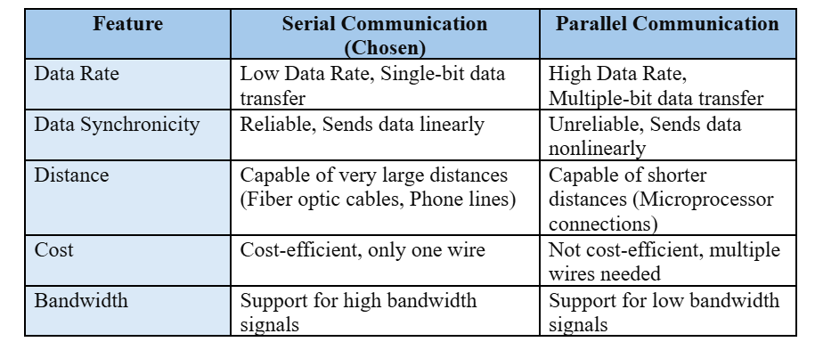
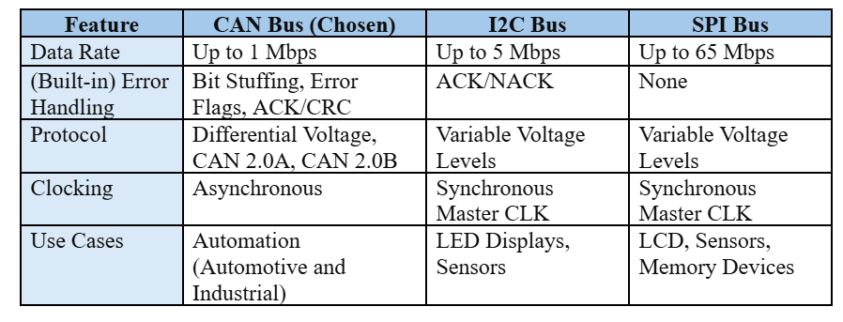
Communication Bus Comparisons:
Chosen Communication Type: Serial for reliability, cost efficiency, and high bandwidth support.
Chosen Bus Type: CAN Bus for use cases, error handling, and data transfer reliability.
CAN Use: Used in automation industry, decentralized framework of nodes that allows for data transfer without having to wait for the bus line to be free.
Notes:
Comparing the CAN devices to other types of communications, we can see that we have far more use cases for the CAN. While the CAN is primarily used in automation and automotive industry, for robotics, it is a top pick. This is because all nodes need to be active at the same time, which SPI and I2C buses are not capable of. You will also notice, we compared the values of serial and parallel communication. CAN buses rae serial communication types, meaning they use two wires to send data one by one. This is done by packaging all of our CAN data into frames, each frame is sent one by one, and read one by one by every other CAN node. This method is far more cost-efficient, capable, and with a built-in system of error checks, far more reliable.

Slide 28
CAN Bus Design: Component Description
Components: MCP25x family used for controller (MCP2515) and transceiver (MCP2551). 16 MHz crystal oscillator. Voltage divider between controller/transceiver RXD lines to prevent damage.
USB Adapter: CANable.io USB adapter used to make CAN data compatible with our computer. Acts as its own CAN node.
Nodes: Each node is built with one ESP32 microcontroller, one MP2515, and one MCP2551.
Data Lines: Each node is attached to the same CAN-H and CAN-L wires for data transfer.
Notes:
As mentioned previously, our components on our CAN devices consist of two chips in the MCP25x family; a MCP2515 controller, and MCP2551 transceiver. A 16MHz crystal oscillator is attached externally to drive the MCP2515 clock signal. During testing we realized that this signal is prone to ringing, and requires proper termination to be read correctly. A voltage divider is placed inbetween the RXD lines of both our MCP chips to avoid burnout. To talk to our computer, we are using a CANable.io USB adapter, making our CAN network compatible with our raspberry pi 5.

Slide 29
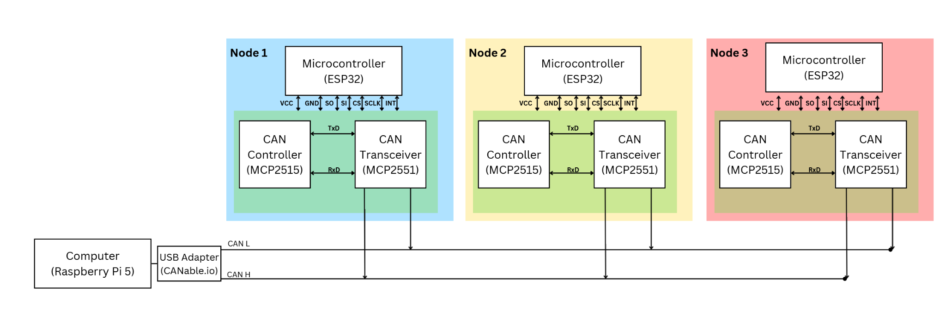
CAN Bus Design: A Visual
Notes:
Here is a visual of how each CAN node connects, and functions with our ESP32 microcontrollers. You will notice that each CAN transceiver is connected to their own CAN-L and CAN-H lines. These then connect to our CAN usb adapter. At the ends of this bus, two nodes have termination resistors, allowing for a successful communication between all nodes and making a closed data channel.

Slide 30
Description | Current (A) | Voltage (V) | Max Power (W) | Quantity | Max Total Power (W)
Stepper Motor | 4 | 24 | 96 | 3 | 384
End Effector Servo | 160m | 6 | 0.96 | 1 | 0.96
Joystick Subsystem | 50m | 5 | 0.25 | 1 | 0.25
Raspberry Pi 5 | 2.5 | 5 | 12.5 | 1 | 12.5
ESP32 WRoom MCU | 1100m | 3.6 | 3.96 | 3 | 11.88
Position Sensor Encoder | 12m | 3.3 | 0.0396 | 3 | 0.1188
Current Sensor | 14m | 5 | 0.07 | 3 | 0.21
CAN Bus Controller (MCP2515) | 10m | 5.5 | 0.055 | 3 | 0.22
CAN Bus Transceiver (MCP2551) | 200m | 4.5 | 0.9 | 3 | 2.7
3.3V-5V Boost Regulator | 2.5 | 5.5 | 13.75 | 1 | 30.25
24V-3.3V Buck Regulator | 3 | 30 | 90 | 1 | 90
Logic Level Driver (SN74AHCT125N) | 25m | 0.5 | 0.0125 | 1 | 0.0125
Total Power |  |  | 533 Watts
Power Supply Distribution Table
Notes:
A power supply for a robot arm is essential to provide the required energy to operate its various components, such as motors, sensors, controllers, and other parts of the system. The power supply type and specification would depend on the arm's application, size, and components.
This Power Distribution table is used to summarize and organize how electrical power is distributed in a system. It details the power sources, loads, wiring, and connections, providing critical information about voltage levels, current requirements, and power capacities for each component in the system. As you can see, after the power was calculated from each component by multiplying the maximum output voltage and maximum output current together, all the power values are added to obtain the total power value of 533 Watts. Therefore, a power supply that has more than 533 Watts is needed. Thus, a power supply with 600 Watts was needed

Slide 31
Power Supply Technological Comparison
Feature | Linear Power Supply | Switching Power Supply (Chosen) | Battery Power Supplies
Efficiency | Low (40-60%) | High (85-95%) | Medium (Depends on type
Size & Weight | Large, Heavy | Compact, Lightweight | Depends on battery capacity
Cost | Low to Moderate | Moderate to high | Very low to moderate
Complexity | Simple | Complex | Moderate
Portability | Not Portable | Fixed Installation | Portable
Reliability | High | High | Medium
Protection | Basic | Advanced | Basic to Advance
Notes:
After deciding that 600W was the power value slected, we needed to find the correct kind of power supply that would work robot arm.
Different power supply types offer distinct advantages and trade-offs in terms of efficiency, cost, size, reliability, and performance.
Selecting the right type ensures optimal performance, safety, and cost-effectiveness for the intended use..
Eventually, it came down to three options, which were Linear, Switching, and Battery Power Supplies
Ultimately, a switching power supply was selected because they were highly efficient and reliable, it was compacted & lightweight and it has the best advanced protection features.

Slide 32
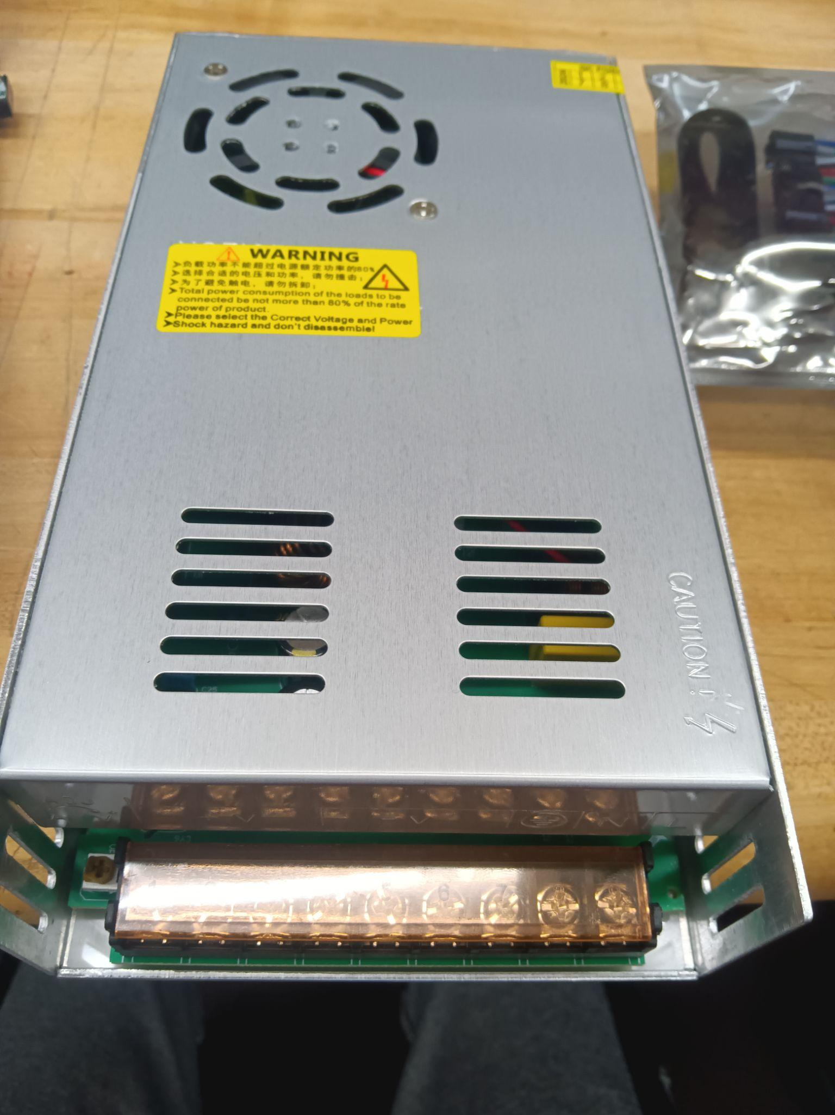
Power Supply Part Comparison
Feature | Mean Well LRS-600-24 (Chosen) | Delta Electronics PJT-24V600WBAA | TDK-Lambda RWS600B-24
Power | 600W | 600W | 600W5
Efficiency | 91% | 89% | 88%
Size | Compact | Compact | Compact
Reliability | Very High | Very High | Very High
Cost | $29.99 | $175.46 | $195.24
Mean Well LRS-600-24
Notes:
As stated in the previous slide, a switching power supply was selected. The Final part was figuring out which switching power source to pick
There were several key specifications when selecting the best type of switching power supply such as the amount of power, efficiency, size, reliability and cost
Ultimately, the Mean Well Mean Well LRS-600-24 was selected due the right amount of power, high efficiency, and it was affordable to purchase

Slide 33
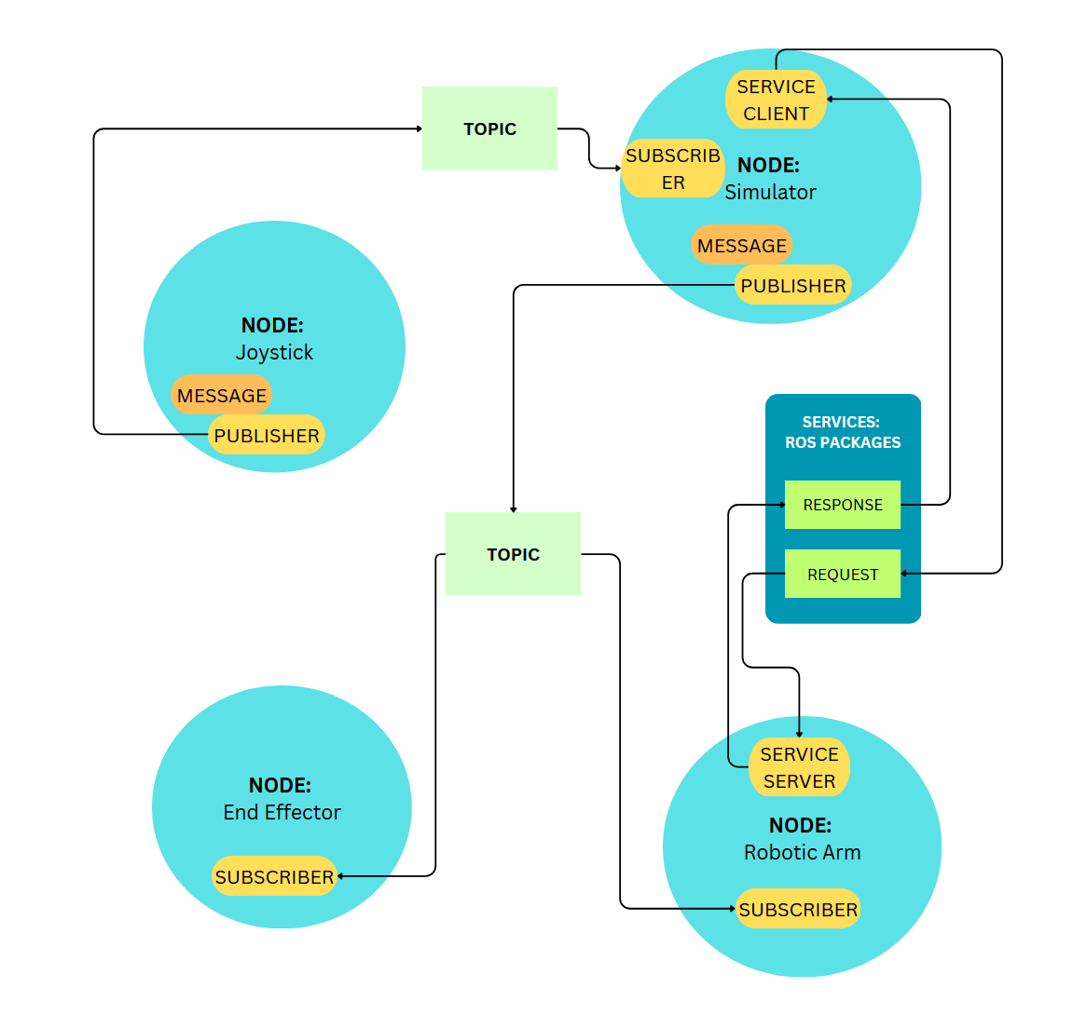
The Software:
How we instruct the hardware and implement a feedback system
Notes:
“Now let’s take a look at how the software is designed”

Slide 34
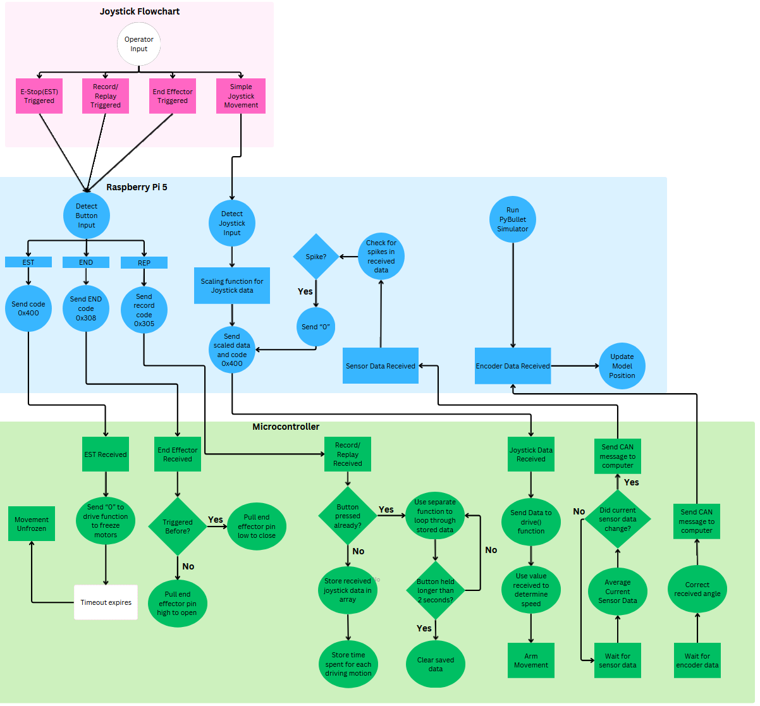
System Flowchart
Notes:
Here is a general overview of our software flowcharts. This is a bit hard to read, so we’ll go section by section, and explain the nuances to each one.

Slide 35
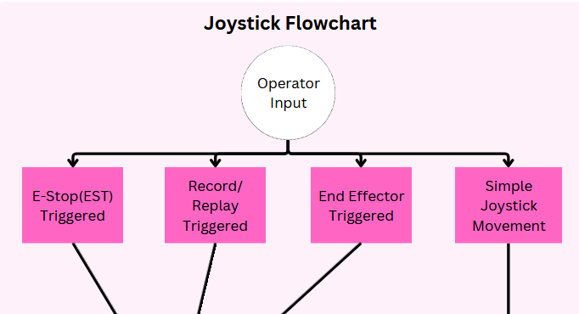
Joystick Logic
Notes:
Starting with the joystick operations, there are four main functions. The joystick input, which provides movement data to our raspberry pi, which then maps these values in a readable fashion to our ESP32 microcontrollers. Next are our three buttons, the emergency stop button to freeze all motor movement, the record+replay function to replay motor movement, and triggering our end effector to open/close, allowing us pick up objects. Now I’ll let Emanuel explain a bit more in depth.

Slide 36
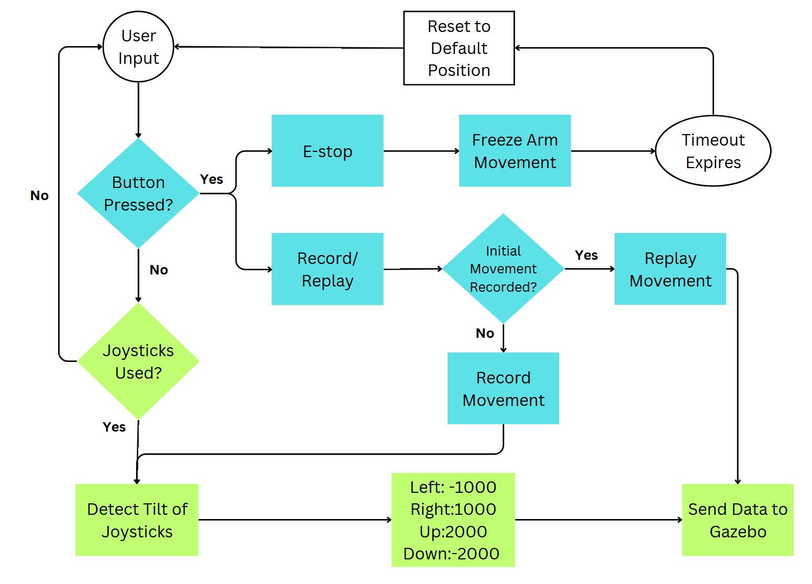
The Joystick Code
Notes:
For this slide, we're looking at the flow of the joystick code. At the core of the joystick’s functionality is user input. When a button is pressed, the system checks which button it is. If it’s the emergency stop, the arm's movement will freeze immediately, and operations will halt until the system is reset or the timeout expires.
If the record/replay button is pressed, we check whether a movement has already been recorded, then a recording event begins and the following joysticks movements will be recorded if no recording has been saved already. The system will replay the movement for automated tasks. This allows the user to automate repetitive tasks, improving efficiency and control.
If no buttons are pressed, we check if the joysticks are being moved. If they are, we detect the tilt and direction of the joystick and convert that into movement data for the robotic arm. This data is sent to the raspi and then from there to the respective esp32 for the intended motor. Also included is a simple end effector button that just sends an open and close signal to the servo holding the parallel gripper.

Slide 37
Handling Joystick Data
Detects all joystick data using evdev library.
All joystick data is read from 0-65565, and is thus scaled down to 1-255.
0 is reserved for stopping motor movement.
Smaller numbers indicate less intense joystick movement.
All three buttons trigger different data to be sent.
Raspberry pi handles polling of button presses to track how long a recorded segment was.

Slide 38
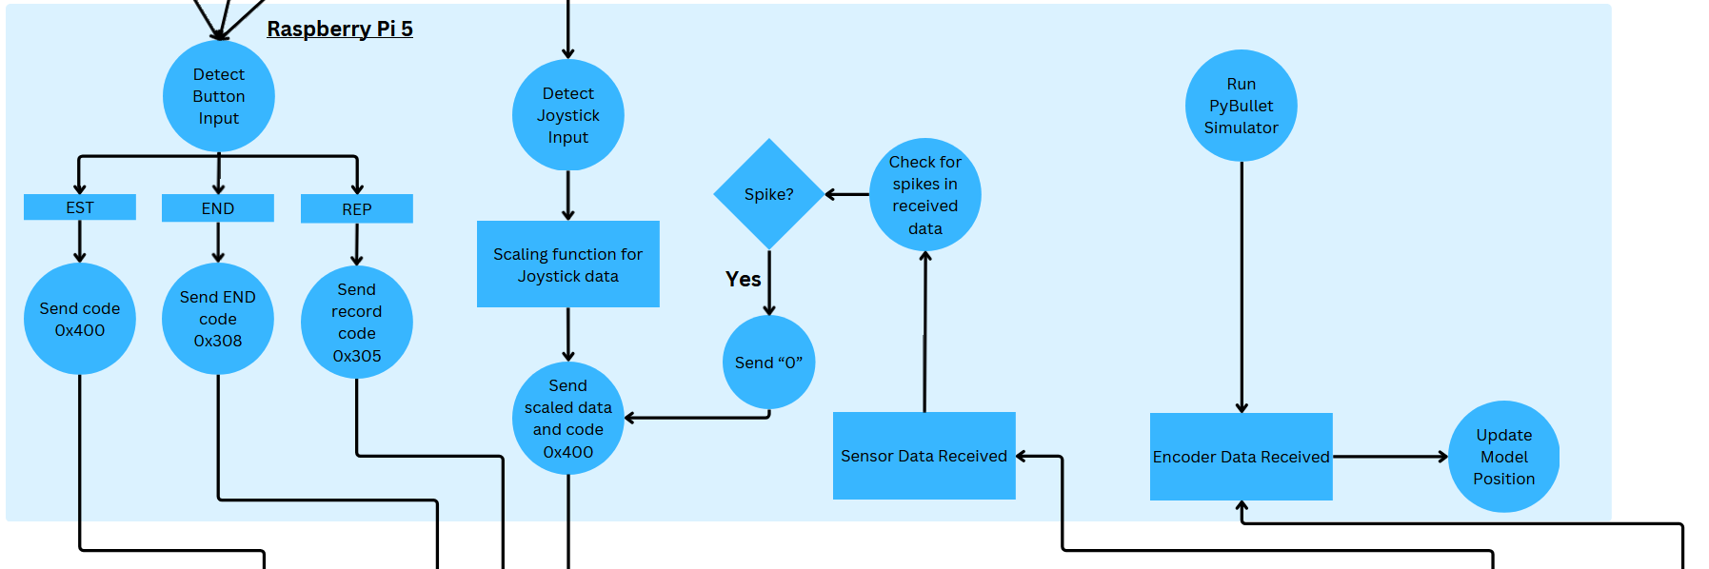
Raspberry Pi 5 Logic
Notes:
Our raspberry pi handles all the scaling, polling, and other mathematical data. It sends codes depending on which part of our joystick is triggered, and uses a timer to record movement. When the pi receives current sensor data and detects a spike, it freezes the motors. When the raspberry pi detects encoder data sent, it then sends this information to our 3D simulator.

Slide 39
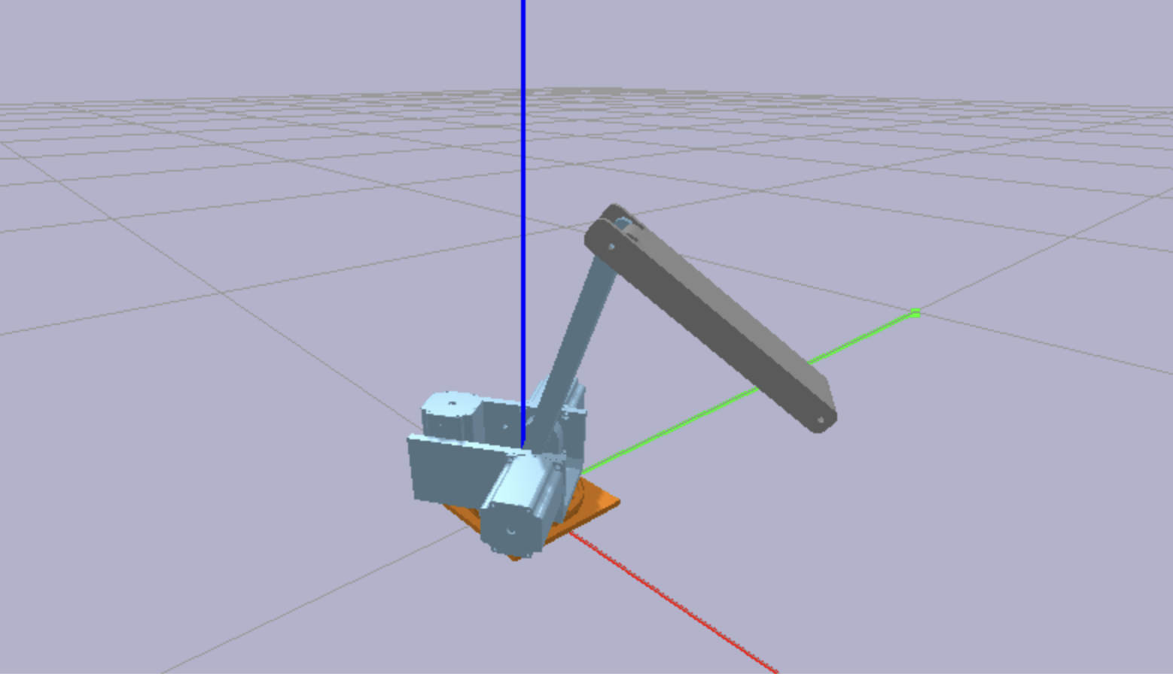
Visualizing the Robot with PyBullet
From CAD to Simulation:
Using the CAD model of our robot, we developed a URDF file that describes the robot’s structure, joints, and kinematics.
This URDF is visualized live in PyBullet, enabling real-time monitoring of the robot's movements.
URDF/SIM Use Case:
Debugging Tool
Planning Validation
Kinematics Testing

Slide 40
Why Visualize the Robot?
Key Benefits:
Debugging Tool: Visualization allows real-time observation of robot motion, identifying issues like joint misalignment or unexpected behaviors.
Planning Validation: Ensures the robot’s movement and task execution are correct before physical testing.
Kinematics Testing: Provides immediate feedback on joint states, ensuring the robot follows intended paths and constraints.
Simulation-First Approach: Saves time and reduces the risk of hardware damage by resolving problems in a virtual environment.

Slide 41
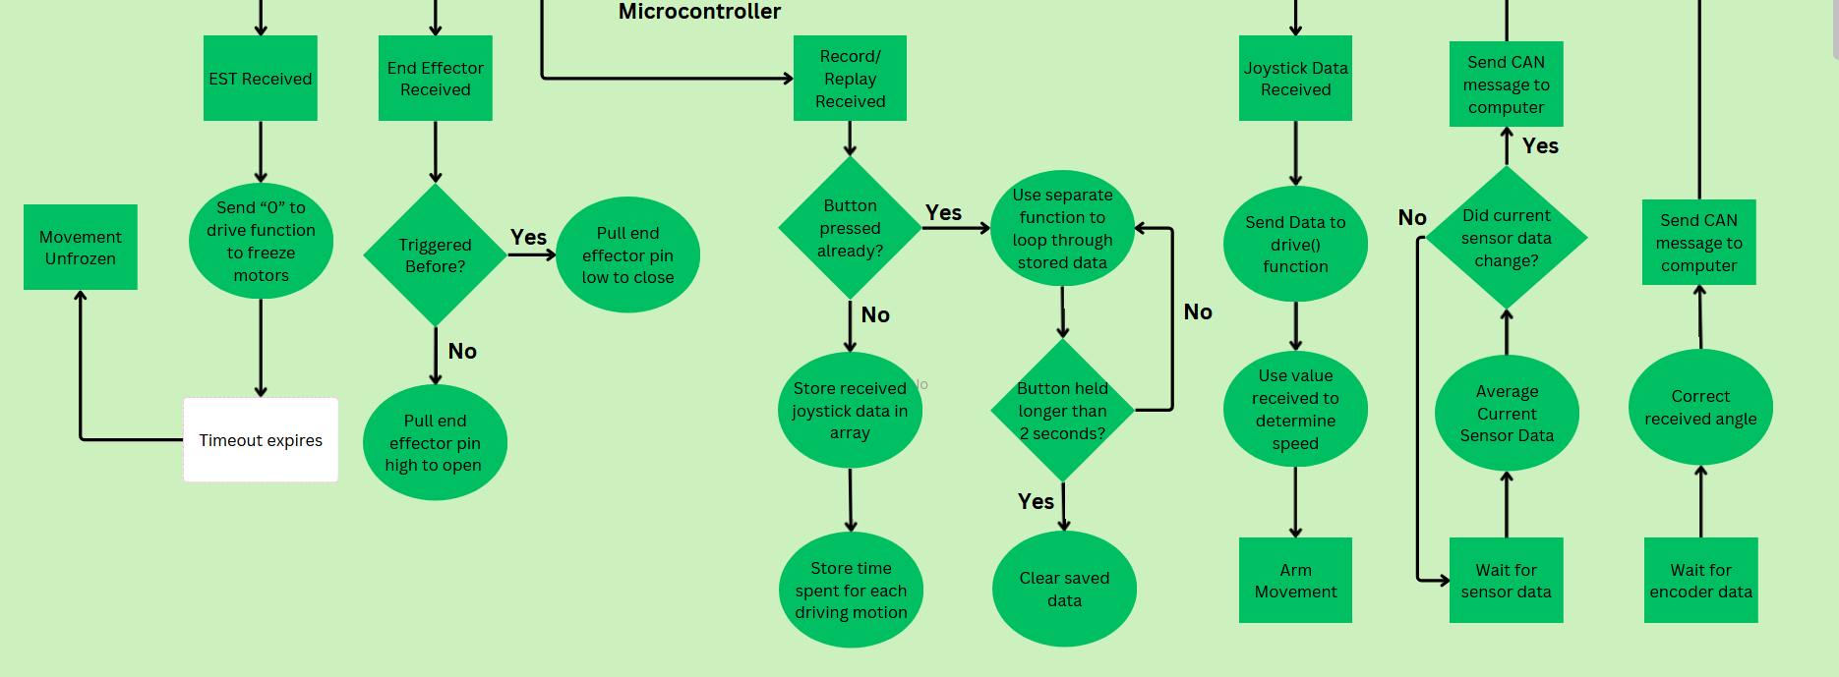
Microcontroller Logic
Notes:
Now for our microcontroller data. Our MCUs handle a big portion of our logic, including driving the actual motors. Here we can see a clear flowchart of how that works, but I believe it will be helpful to break this down bit by bit.

Slide 42
ESP32s: Using Arduino IDE and C/C++
By taking in joystick data from our central computer, each ESP32 acts fairly similar to the next, handling basic functions and less complex mathematical processes.
Write functions to handle incoming encoder and current sensor data, update on changes detected in the sensors.
Use “mcp2515” library to send and receive CAN messages.
Drive motors based on joystick input received from Raspberry Pi.
Freeze, record, and replay motor movements, as well as activate end effector based on joystick input received from Raspberry Pi.
Notes:
By using the mcp2515 library, we are able to send and receive can data over our ESP32s. In this way, we are able to send encoder and current sensor data.

Slide 43
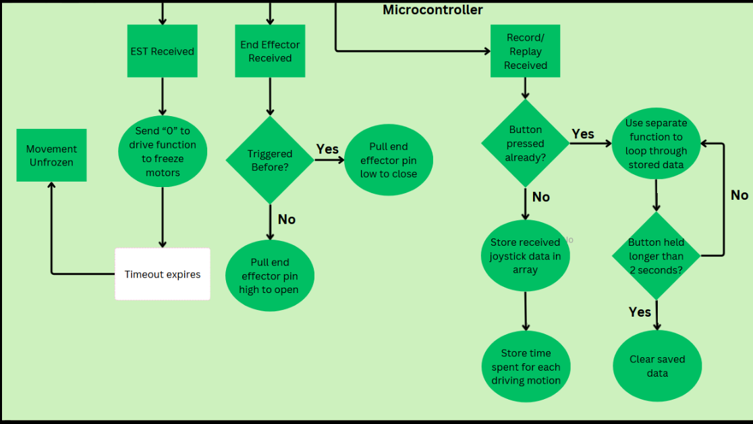
Button Behavior

Slide 44
ESP32s: Handling Encoder/Sensor Data
Each node handles its own encoder/current sensor.
Each node uses the same code to check for changes within the encoders/current sensors.
Current sensor data is averaged to check for spikes, indicating a collision or obstruction.
Encoder data is used to detect the angle of our motors, ensuring our robotic arm does not go over a determined maximum and can be reset to a default position
Each node has unique ID for encoder/sensor data to send to the main computer, which then uses this data to adjust behaviour of our motors.

Slide 45
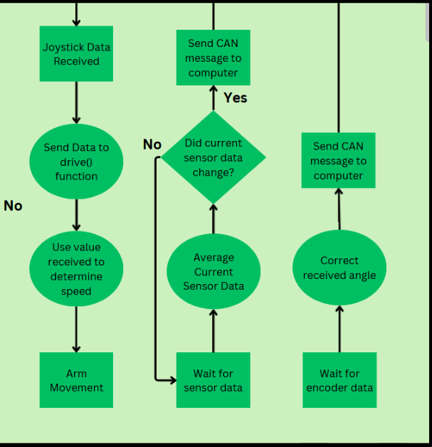
Joystick + Sending Messages Behavior

Slide 46
ESP32s: Motor Behavior
Joystick data from our Raspberry Pi is regularly received
Motors are driven continuously, unless interrupted by a higher-priority task (Ex: Emergency Stop)
Each node is programmed to receive data from specific CAN IDs sent from our computer

Slide 47
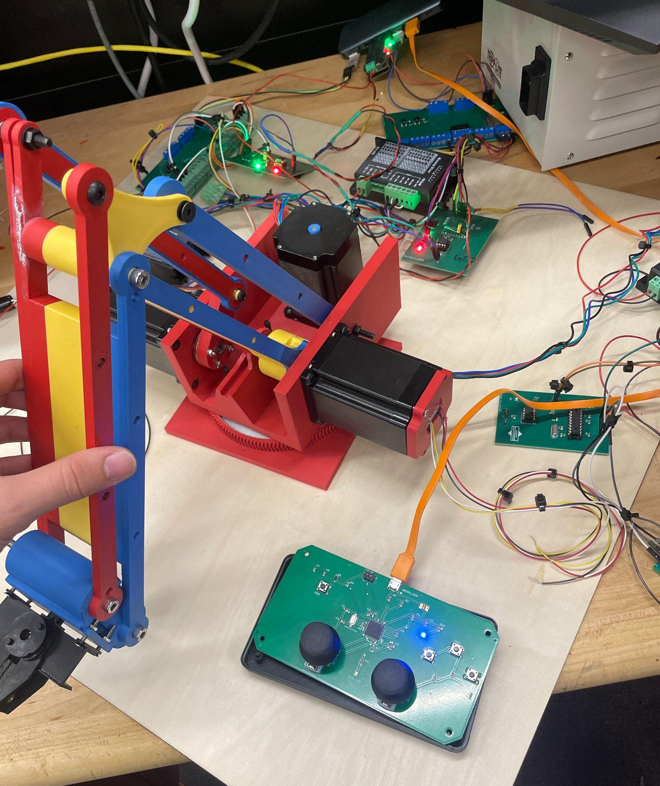
Final
PCBs & Testing
Integration of all PCBs
Notes:
The following slides showcases the final integration of all PCBs and their role in our robotic arm system.
It includes the joystick PCB, current sensor PCB, motor MCU PCB, and the CAN bus PCB, all functioning together.
We’ll walk through their schematics, designs, and how each was tested for performance and reliability.
Testing focused on verifying hardware functionality with the written software and ensuring smooth coordination between all subsystems.

Slide 48
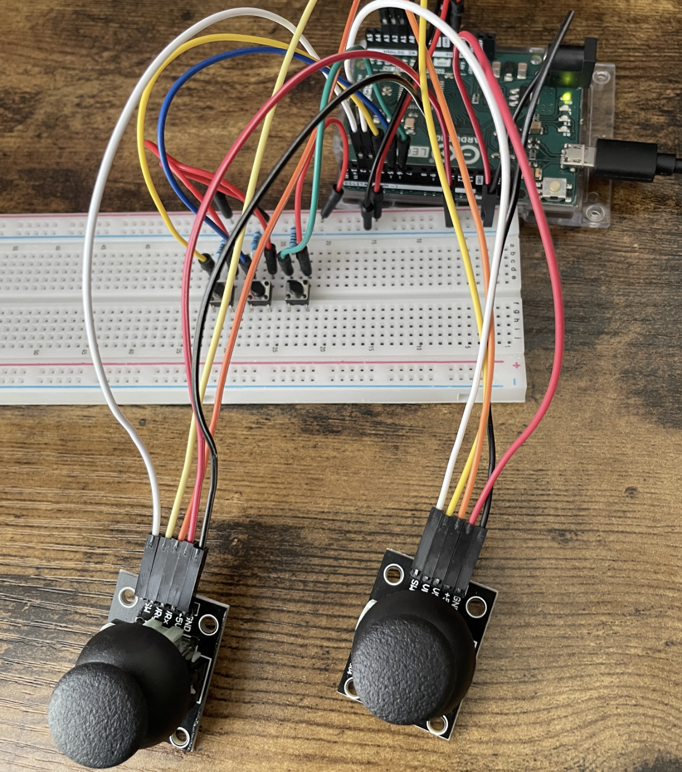
The Joystick Prototype
Breadboard Setup: Prototype built with two joysticks and three push buttons for testing.
Arduino Leonardo: Reads joystick inputs (A0-A3) and button inputs (D0-D2).
Serial Communication: Sends joystick/button data via USB to a laptop, monitored in Arduino IDE.
Features:
X/Y Control: Joysticks simulate robotic arm movement.
Button Inputs: E-stop, record/replay, and end-effector control.
HID Potential: Future HID functionality possible for joystick emulation.
Testing Setup: Connected via micro-USB to laptop for validation and data accuracy.
Joystick Breadboard Prototype
Notes:
So here’s a look at our joystick prototype, which we built on a breadboard to make sure everything works before we move to the final PCB.
We’ve got two analog joysticks and three general-purpose buttons wired up. The joysticks are connected to the analog inputs on an Arduino Leonardo, and the buttons are hooked up to the digital inputs. The Arduino reads the joystick and button inputs and sends that data over USB to a laptop for testing.
The communication between the Arduino and the laptop is done using serial communication, and we monitored the output using the Arduino IDE’s serial monitor.
Some of the key features of this setup:
The joysticks give us X/Y axis control, which we use to simulate the movement of the robotic arm.
The buttons include an emergency stop, a record/replay button, and one to control the end effector.
Since we’re using the Arduino Leonardo, there’s also potential for HID functionality, meaning we could emulate something like a PS4 controller in the future.

Slide 49
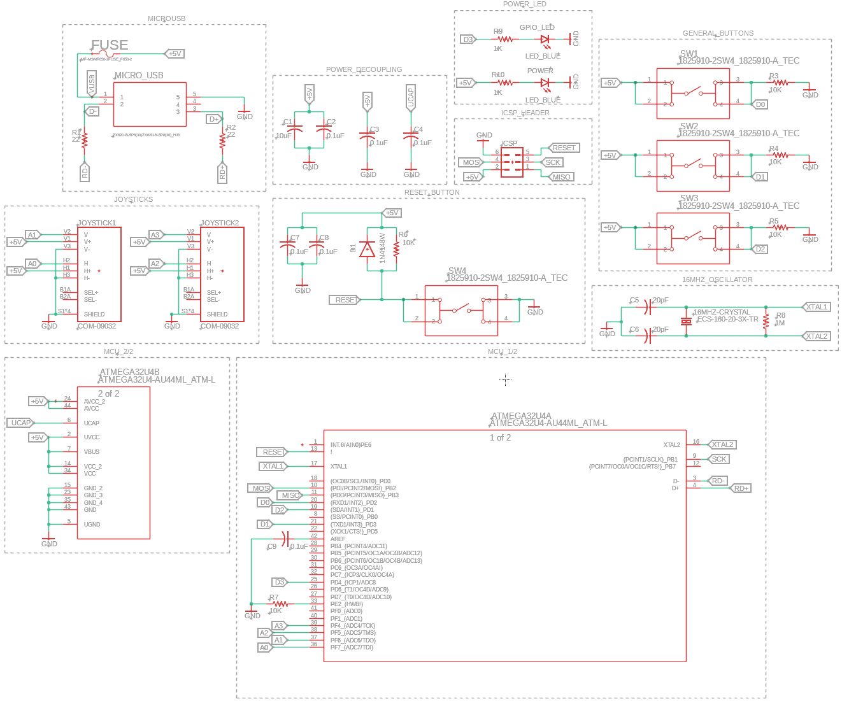
The Joystick PCB Schematic
ATmega32U4-based joystick controller PCB design.
Micro USB connectivity for data transfer and power.
Decoupling capacitors and external crystal oscillator for stable MCU operation.
Implements multiple input buttons and joystick connections.
Power LED and GPIO LED for status indication.
Joystick PCB Schematic Overview
Notes:
Now, let's take a look at the Joystick PCB Schematic. This is the complete design of our ATmega32U4-based joystick controller.
To start with, we have micro USB connectivity, which serves dual purposes: it provides power to the board and also handles data transfer to the Raspberry Pi. To that end, we have added a fuse between Vusb and all other Vcc's present on the MCU and system for safety and testing, ensuring that any unexpected power surges are contained.
To ensure stable operation of the microcontroller, we’ve included decoupling capacitors and a crystal oscillator. These components help maintain a clean, steady power supply and clock signal for the MCU, which is essential for reliable operation.
For input, we’ve implemented four buttons, labeled SW1 through SW4, as well as the connections for our two joysticks. As we mentioned already, the buttons include the record/replay button, the end effector on/off button, the E-stop button for safety, and finally, we've also added a reset button for the MCU to assist with testing during development.
Additionally, we have a Power LED to indicate when the board is receiving power and a GPIO LED that can be programmed for status indication. These visual indicators help us easily monitor the system's state during testing and operation.

Slide 50
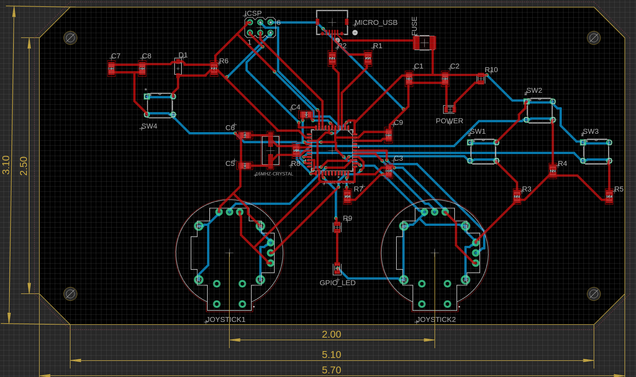
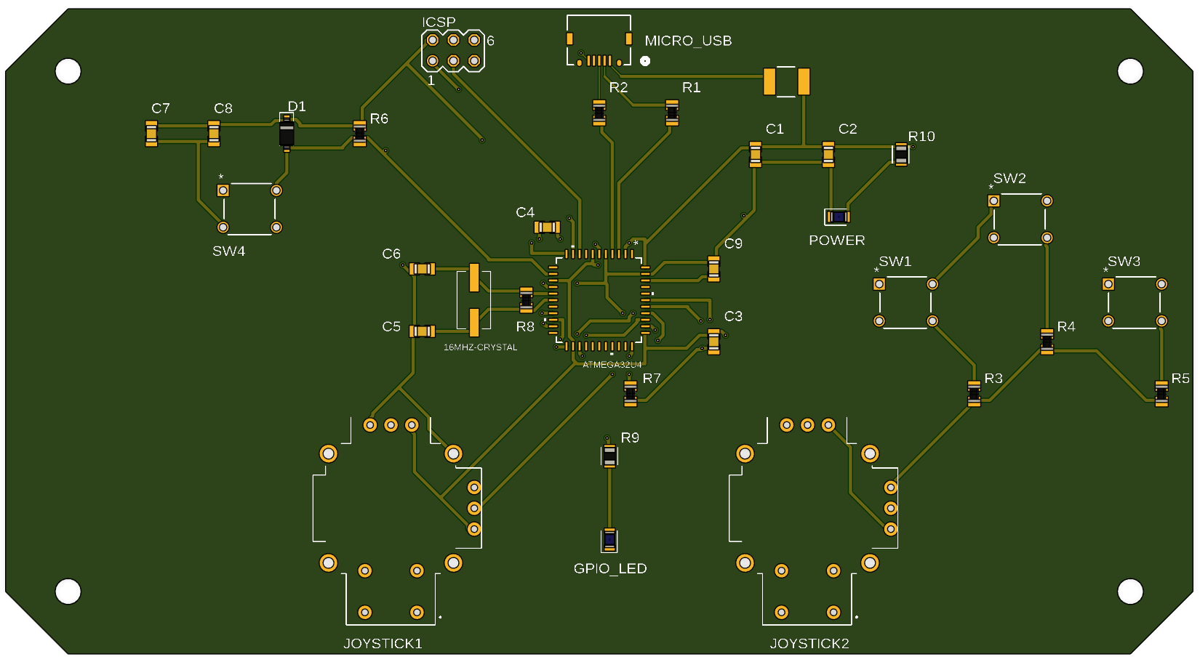
The Joystick PCB Electronic Design
Decoupling capacitors are placed close to the MCU to ensure stable power delivery and noise reduction.
External oscillator near the MCU for accurate clock timing and reliability.
Reasonable spacing and thickness of traces to ensure signal integrity.
Ground pour applied on both layers for improved EMI protection and overall stability.
3D model shows precise component placement and practical mounting hole locations for easy integration.
Joystick PCB Electronic Design
Joystick PCB 3D Top View
Notes:
Moving onto the Joystick PCB Electronic Design. One of the key design choices was placing critical components like the external oscillator and decoupling capacitors close to the MCU. This ensures stable power delivery and accurate clock timing, which are essential for reliable MCU operation.
We also made sure the traces are routed with sufficient spacing to prevent interference and maintain signal integrity, and allow for easier hand soldering if troubleshooting is needed.
Proper ground planes were also poured on the top and bottom layers and interconnected to reduce EMI, and screw holes were included to ensure an enclosure could be 3D printed to protect the PCB has it is intended to be handheld.
In terms of ergonomics, we placed the buttons farther from the MCU to keep the wiring clean and reduce interference and the joysticks at 2 inches apart mimicking a console controller.

Slide 51
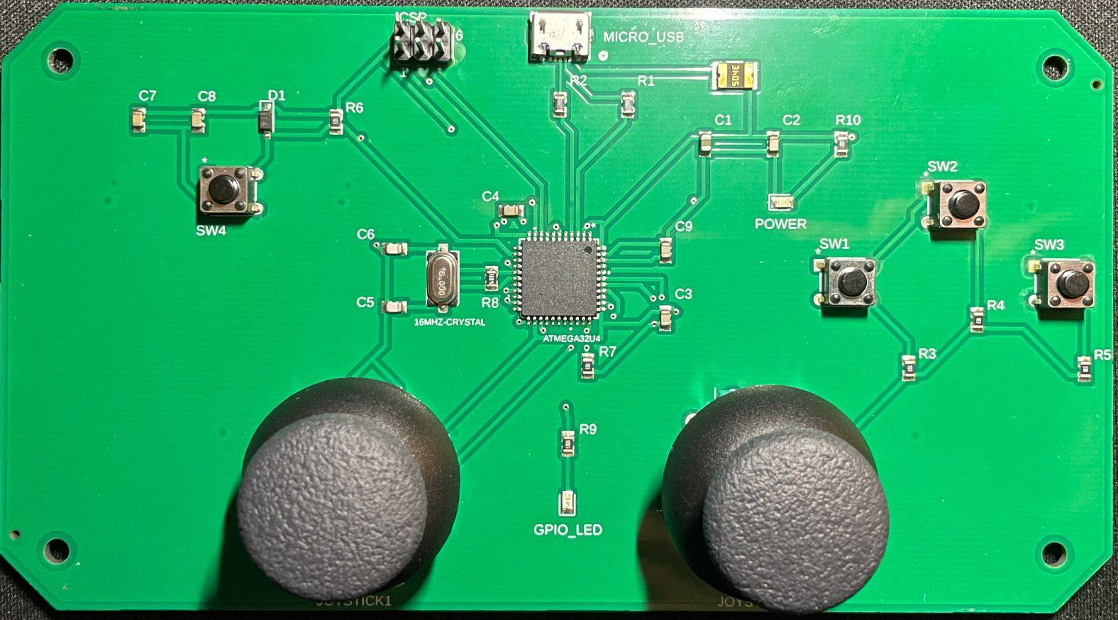
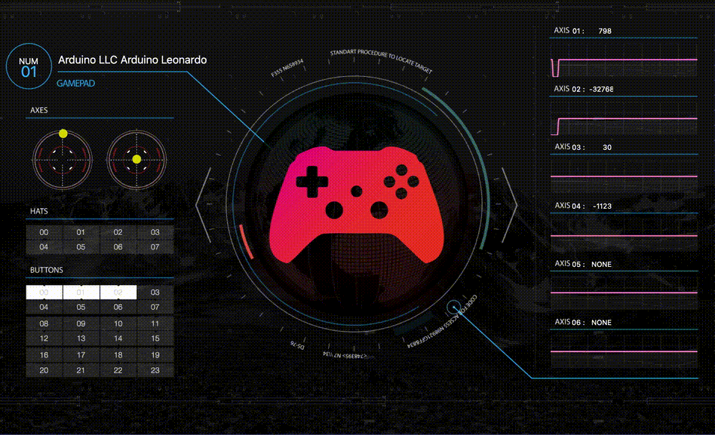
Joystick PCB Testing
PCB Delivered: The ATmega32U4-based joystick controller PCB arrived.
Bootloader Installed: Successfully burned the bootloader via ICSP, enabling Arduino IDE support.
USB Functionality: microUSB is handling both data and power, with HID functionality fully working.
Prototype Testing: Joystick and button outputs are now verified through HID functionality.
Difficulty Overcome: Faced challenges finding the correct method to burn the bootloader due to conflicting online information but found success after some trial and error.
Final Integration: In the conclusion of our project the joystick PCB will connect to the Raspi and control the motors.
Joystick PCB HID Functionality Verification
Notes:
The joystick PCB testing process began once the ATmega32U4-based PCB was delivered.
After soldering on the remaining through hole components the first step was burning the bootloader via ICSP, enabling support with the Arduino IDE. This was crucial to initialize the microcontroller for our project, otherwise we would have to write the firmware and driver ourselves in C.
During prototype testing, we verified the joysticks and buttons by connecting the PCB to a laptop and observing outputs through the HID functionality.
One challenge we faced was finding the correct method to burn the bootloader, as conflicting online information caused some trial and error. However, we successfully resolved this issue, found the right series of steps, and managed to boot it into essentially mimicking an arduino leonardo which houses the same ATmega32u4.
The final step involved integrating the joystick PCB with the Raspberry Pi and motor system to fully control the robotic arm. This testing ensures the entire system operates smoothly and reliably.

Slide 52
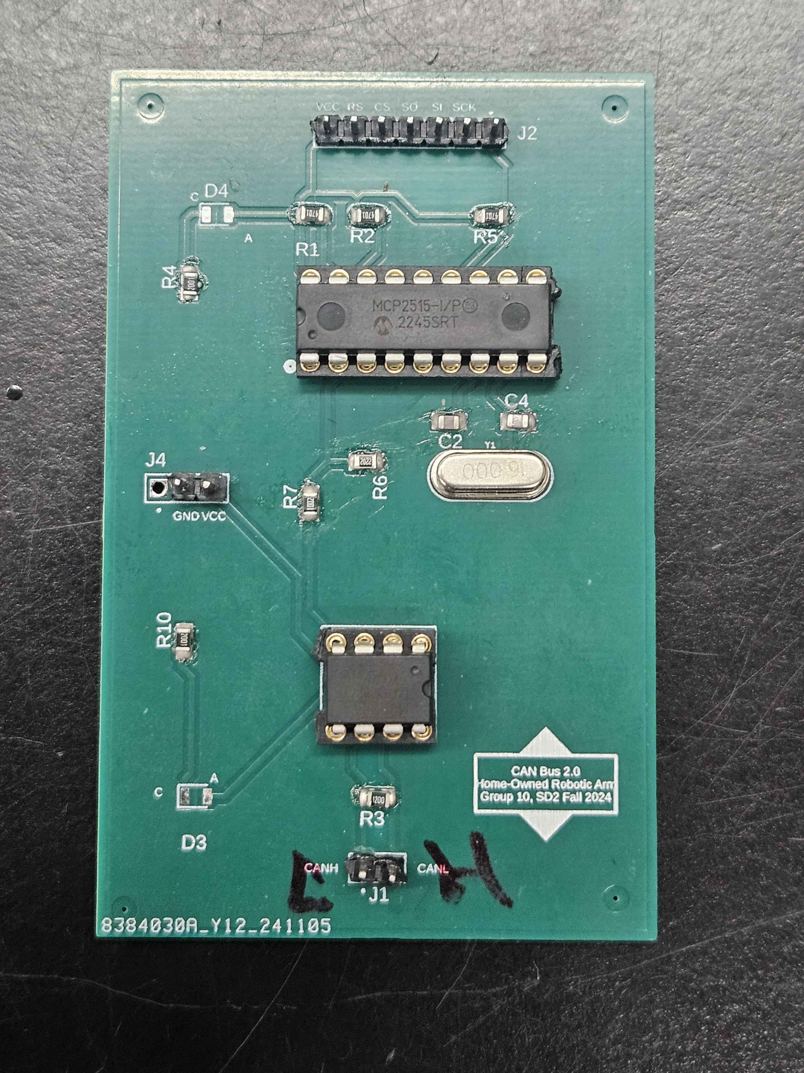
Communication Bus: CAN PCBs
Our chosen communication system for all hardware components is a Controller Area Network (CAN) bus.
Custom PCB: Designed to connect all ESP32s to each other and to computer, main communication line between all hardware.
Major Components: MCP2515 18-dip controller chip used for taking and processing SPI data. MCP2551 8-dip transceiver chip to send and receive data across CAN-H and CAN-L lines.
SPI Pinouts: 7-pin male pin headers that connect to SPI bus of our ESP32s. LED indicates power across the 3.3V line. Connects to our MCP2515.
5V Connection: 2-pin male pin headers to connect 5V from our ESP32s to our MCP2551.
Data Lines: 2-pin male pin headers to send data over CAN-H and CAN-L lines.
Other Important Additions: Voltage divider across the RXD lines of both chips, to prevent 5V line going back into 3.3V line and frying our MCP2515.
CAN Bus PCB
Notes:
“Force control is a prominent issue within industrial automation. Automated robots are designed to boost efficiency and accuracy across manufacturing lines, and they do this well! However, these machines still require human operators to work alongside them to ensure quality control. This human element poses a danger, since these robotic arms rarely have force control implemented. This means that if a robotic arm swings against or comes across a human operator in any way, there will most certainly be a major injury occurring. While this industry is not lacking in safety as a whole, this small feature could greatly reduce the number of fatalities among injuries. However, how do we implement something like this?

Slide 53
Testing: CAN PCBs
Known Working Devices: Used Amazon-purchased MCP2515 canboards to test that our designed boards were working as expected. Tested each one-by-one, then slowly integrated all three into the system.
Problems encountered: MCP2551 transceiver burned when exposed to too much voltage.
Solutions:
Use bypass capacitors for the system when running all three canboards, attached to voltage and ground of both ICs
Use voltage divider between MCP2515 RXD and MCP2551 RXD, to prevent 5V from flowing into our 3.3V device.
CAN Bus PCB
Notes:
“Force control is a prominent issue within industrial automation. Automated robots are designed to boost efficiency and accuracy across manufacturing lines, and they do this well! However, these machines still require human operators to work alongside them to ensure quality control. This human element poses a danger, since these robotic arms rarely have force control implemented. This means that if a robotic arm swings against or comes across a human operator in any way, there will most certainly be a major injury occurring. While this industry is not lacking in safety as a whole, this small feature could greatly reduce the number of fatalities among injuries. However, how do we implement something like this?

Slide 54
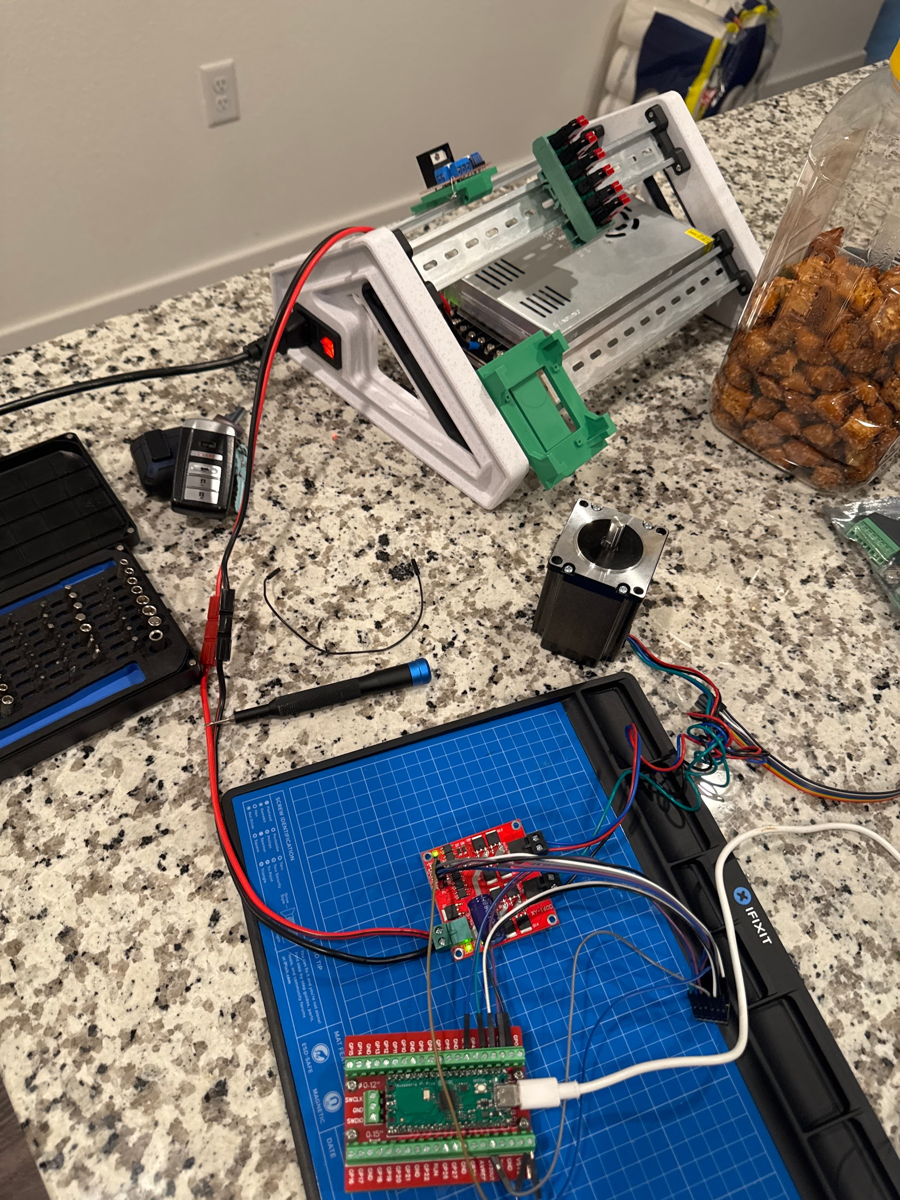
Testing
In testing we demonstrated open loop position , velocity , acceleration control. In testing the initial board we used has mosfets go bad from the large back emf of the motor and we had to change H bridge component selection.

Slide 55
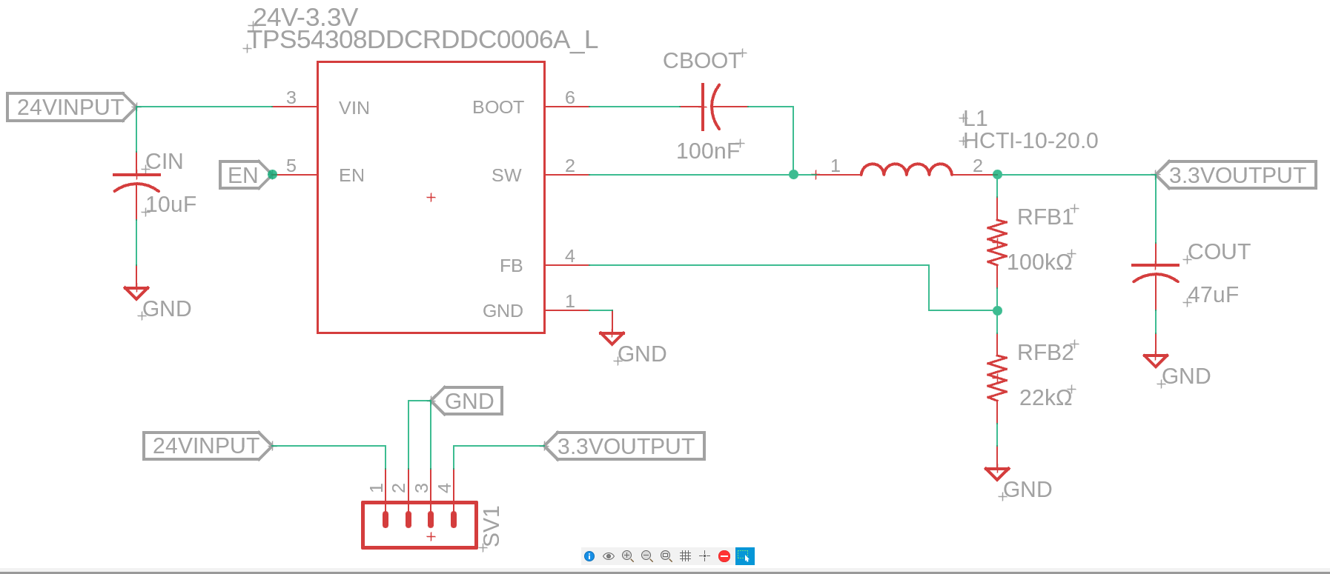
Switching Buck Regulator
Voltage Drop Requirement: 24V-3.3V
TPS54308DDCR
Input Voltage: 4.5V-28V
Output Voltage: 1V-28V
Output Current: 3A
Efficiency: 87%
Supplies Voltage for:
ESP32 Wroom MCU
Position Sensor Encoder
3.3-5V Boost Regulator
24V-3.3V Buck Regulator Schematic
Notes:
Since there are several components in the system where low voltage is needed, the 24V coming from the power supply would need to be converted.
Switching buck regulators are used to step down a higher voltage to a lower voltage efficiently
Their purpose is to convert electrical energy with minimal loss compared to linear regulators.
Firstly, a switching buck regulator that can drop 24Vs down to 3.3Vs was needed
The TPS54308DDCR was a useful regulator to use due to high efficiency and a good compact size
This regulator has an Input Voltage: 4.5V-28V, Output Voltage: 1V-28V, Output Current: 3A, Efficiency: 87%
This regulator can Supplies Voltage for ESP32 Wroom MCU, Position Sensor Encoder & a 3.3-5V Boost Regulator
Pictured on the right is the schematic of the 24V-3.3 Buck regulator consisting of resistors, capacitors, and an inductor

Slide 56
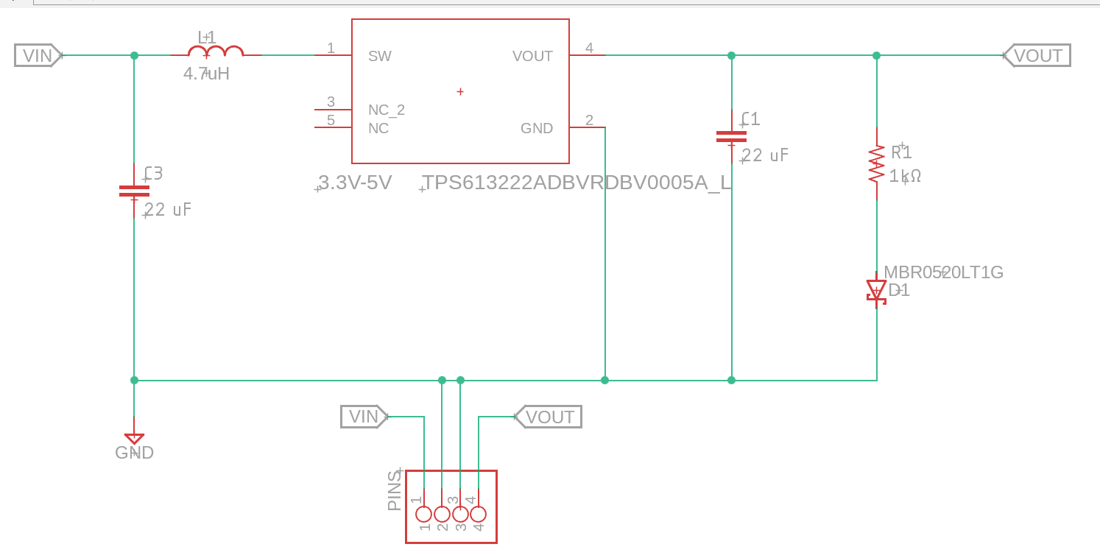
Switching Boost Regulator
Voltage Boost Requirement: 3.3V- 5V
TPS613222ADBVR
Input Voltage: 900mV-5.5V
Output Voltage: 5.5V
Output Current: 1.8A
Efficiency: 87%
Supplies Voltage for:
Current Sensor
CAN transceiver
Motor Controller
3.3V-5V Boost Regulator Schematic
Notes:
As mentioned on the previous slide, a Switching Boost Regulator would also need to be included within our system.
This device can increase the input voltage to a higher output voltage by storing energy in an inductor and then releasing it at a higher voltage level.
Since we wanted the voltage to increase from 3.3V to 5V, The TPS613222ADBVR was the right choice also due to high efficiency and a good compact size
This regulator has an Input Voltage: 900mV-5.5V, Output Voltage: 5.5V, Output Current: 1.8A, Efficiency: 87%
This regulator can Supplies Voltage for Current Sensor, CAN transceiver, and can also be a reference voltage for the Motor Controller
Pictured on the right is the schematic for the 3.3 to 5V Boost Regulator consisting of capacitors, a resistor, an inductor, and a Schottky Diode which can also be an LED.

Slide 57
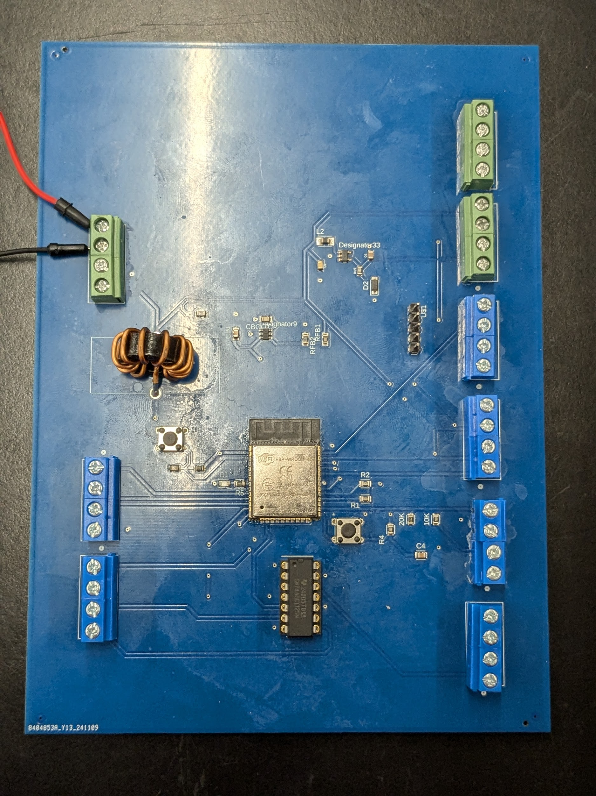
Unified MCU and Regulator PCB
The Unified MCU and Regulator PCB serves to communicate with the motor controller and sensors and integrates regulators to power the MCU as well and its connected devices
Custom PCB: Designed to integrate the ESP32 Wroom microcontroller with regulators to power it and its connected devices
24 to 3.3 Step Down: Uses a TPS54308 buck converter to step down from 24 to 3.3V to power the MCU, encoders, CAN controller, and boost converter
3.3 to 5 Step Up: Uses a TPS613222A boost converter to step up from 3.3 to 5V to power the CAN transceiver, current sensor, and reference voltage for the motor controller
3.3 to 5 Logic Level Shifter: A SN74AHCT125N Logic Level Shifter is used to convert the 3.3 logic level from the MCU to 5 to communicate with the motor controller
Power and Data Pins: Pinouts for 3.3V, 5V, and data are included
Unified MCU PCB
Notes:
This is the Unified PCB we designed that integrates the ESP32 microcontroller with a pair of regulators that allow both it and its connected devices to be powered at their appropriate voltages. It features a 24 to 3.3 buck regulator to step down voltage from the power supply to power the microcontroller, position sensors, and CAN controller, a 3.3 to 5 boost regulator to power the CAN transceiver, current sensor, and provide reference voltage to the motor controller, as well as a 3.3 to 5 volt logic level shifter to connect data lines at their appropriate logic levels.

Slide 58
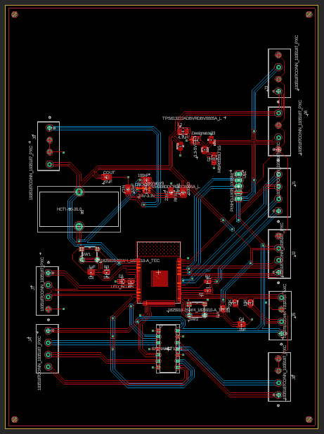
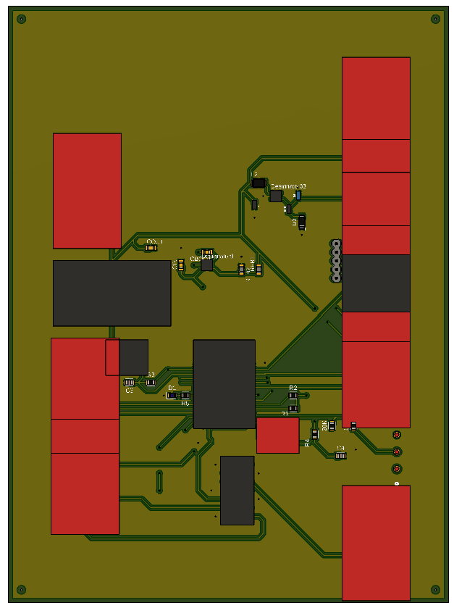
Unified MC and Regulator Electronic Design
Recommended layout in the datasheet was referenced during the design process
Feedback resistors are placed close to the IC to reduce the length of the feedback connection
Vias to the GND plane are used to reduce trace length and improve connection to GND
Capacitors, inductors, and diodes are placed close to the IC to mitigate noise
Switching regulators are positioned further from the analog pins of the MCU to reduce noise impact from the regulators
Unified PCB Electronic Design
Unified PCB 3D Top View
Notes:
This slide shows the layout of the electronic design for the microcontroller and regulator board. On the top right is the 3.3 to 5 volt regulator circuit and to the bottom left of that is the 24 to 3.3 regulator circuit. Below that is the microcontroller footprint and beneath that is the logic level shifter. The top left screw terminal contains the 24 volt input pins and the other screw terminals include data lines and 3.3 and 5 volt output pins. Lastly the 5 pin header includes the data pins to program the microcontroller. The layout for the regulators was made using the recommended layouts in the datasheets as reference, though there are still significant discrepancies between the recommended layout and the final electronic design. Positioning of the components including capacitors, inductors, and connections to the ground plane was decided taking mitigation of interference into account.

Slide 59
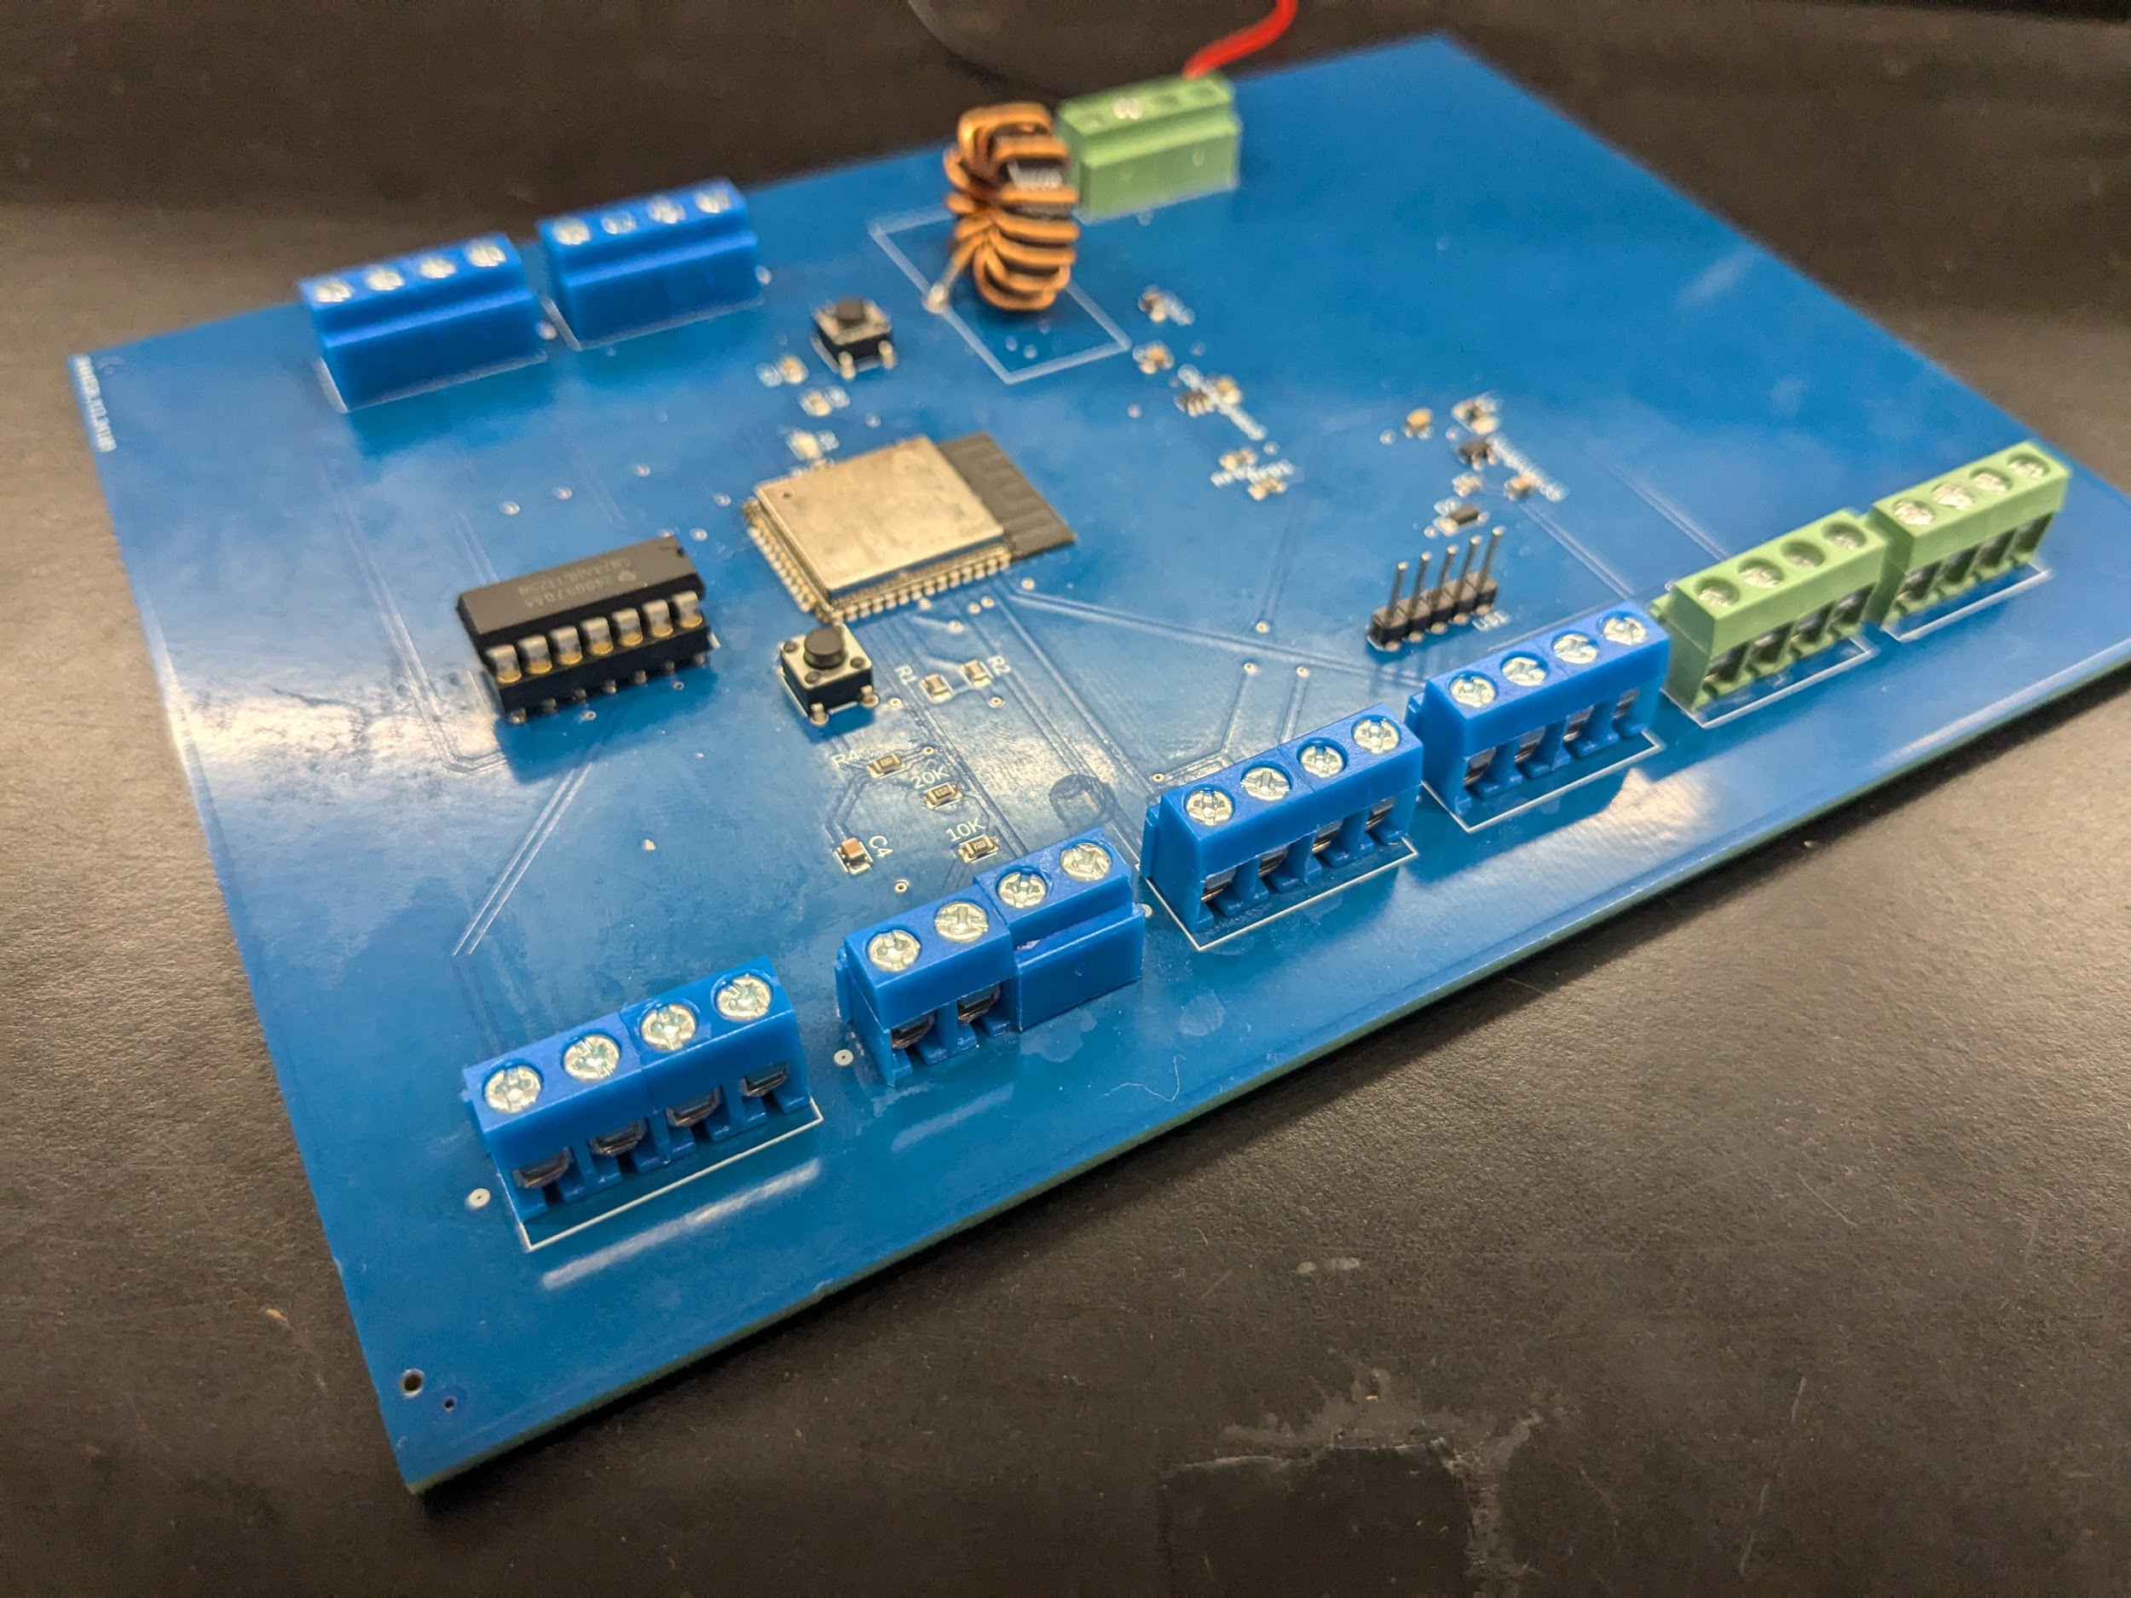
Unified MCU and Regulator Testing
In testing we demonstrated functionality of the MCU and integrated regulators
Problems encountered: A standalone version of the 24 to 3.3 voltage regulators began to drop voltage while testing under load.
Solutions: The surface mount inductor on the earlier design was replaced with a through hole inductor with the proper voltage rating.
Results:
Correct voltage regulation: 3.3 and 5 volts were measured at the appropriate output pins.
Test under load: regulators were tested outputting currents exceeding maximum expected loads for each regulator without dropping voltage.
Functionality of the MCU: the microcontroller successfully was booted and programmed to run a simple LED flashing
Integration with CAN bus and motor controller systems
Unified MCU PCB
Notes:
Testing the unified PCB involved a similar process to testing the dedicated microcontroller board in that we programmed it, tested how it ran code and integrated with other devices. The difference is that before we could get to that, we first had to make sure the buck and boost regulators were both reaching their proper voltages and were functioning under a load. An earlier iteration of the 24 to 3.3 buck converter failed under load testing and a solution we found was to replace the surface mount inductor with a through hole one with a higher current rating appropriate to the specifications in the datasheet. After we found success with the regulators the microcontroller was soldered on so it could be programmed and integrated with other parts of the motor control subsystem.

Slide 60
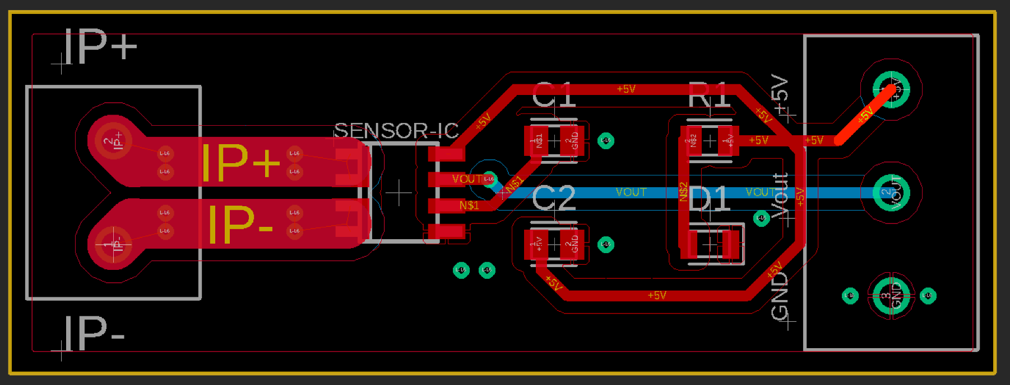
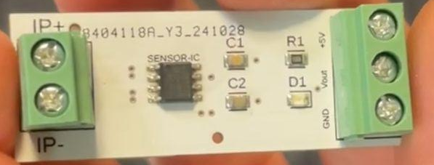
Current Sensor PCB
100 mil traces used for IP+ to IP- on both top and bottom layers, with multiple vias to prevent overheating under maximum current.
Decoupling capacitors placed close to the IC to stabilize voltage and reduce noise.
A power indicator LED included for visual confirmation of circuit functionality.
Screw terminals used to allow for thicker, secure wire connections.
Compact and efficient design for simplicity.
Ground pour applied for enhanced EMI protection and thermal dissipation.
Current Sensor PCB Electronic Design
Current Sensor PCB
Notes:
This slide covers the design of our Current Sensor PCB, which measures current using a Hall Effect sensor.
We used 100 mil traces for IP+ to IP- on both the top and bottom layers, with multiple vias to handle maximum current and prevent overheating.
Decoupling capacitors were placed close to the sensor IC to stabilize the voltage supply and reduce noise, ensuring accurate current readings.
A power indicator LED was added for visual confirmation of proper circuit functionality.
Screw terminals were used to allow for thicker, secure wire connections, making the board suitable for high-current applications.
The design is compact and efficient, prioritizing simplicity while maintaining functionality.
A ground pour was applied to enhance EMI protection and improve thermal dissipation, ensuring stable operation under varying conditions.
Overall, the PCB was designed to be robust, reliable, and easy to integrate into our system.

Slide 61
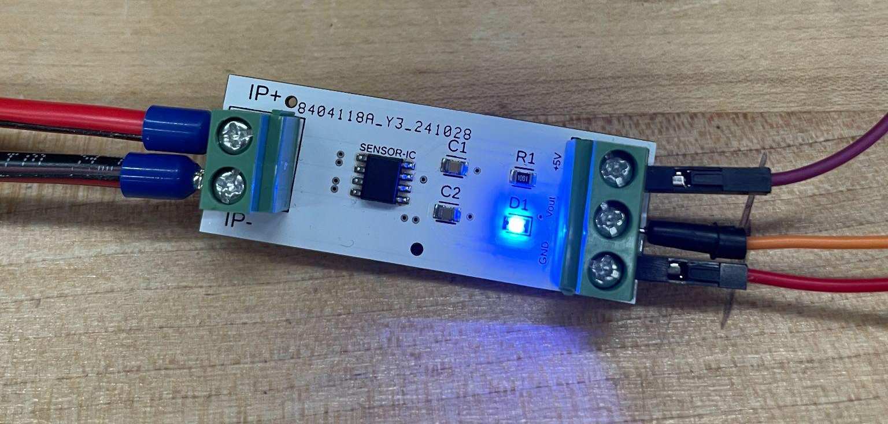
Current Sensor Testing
Initial Setup: Connected the PCB output (Vout) to an Arduino’s analog pin for testing
Testing Code: Used Arduino code to read analog values from the sensor, convert them to voltage.
Sampled analog readings multiple times for accuracy.
Applied calibration offset to account for sensor variations.
Displayed averaged current values on the Serial Monitor.
Load Testing: Connected a load in series between IP+ and IP- to verify current measurements against known loads.
Calibration Challenges: Found that different sensors required unique offsets, which were adjusted and reflected in the MCU code for accuracy.
Current Sensor PCB Wired Up
Notes:
This slide details how we tested the current sensor PCB to ensure it met the design requirements for accurate current measurement.
The testing began with connecting the PCB output, or Vout, to an Arduino’s analog pin. This allowed us to capture real-time sensor data and analyze it in the Arduino IDE.
We wrote a custom Arduino script that sampled the sensor’s output repeatedly, converted the readings into voltages, and then calculated the current using the sensor’s sensitivity. This sampling method ensured we averaged out any noise or fluctuations for accurate results.
To verify its performance, we conducted load testing by placing a load in series between IP+ and IP-, then comparing the measured current to the known value of the load.
A small challenge we faced during testing was that individual sensors required unique calibration offsets due to manufacturing variations. We identified these offsets and adjusted the final esp32 MCU code accordingly, ensuring precise readings for each sensor.
This process was critical in confirming that the current sensor PCB could consistently provide reliable data, which is needed for safety.

Slide 62
The
Final
BOM
Component | Supplier | Quantity | Unit Cost | Total Cost | Notes
Stepper Motor | Stepper Online | 4 | $23.80 | $95.20 | NEMA 23 2.4NM
Rotary Encoder | DigiKey | 4 | $5.76 | $23.04 | Hall Effect position sensors
Current Sensor | DigiKey | 8 | $5.69 | $45.52 | Hall Effect current sensor
ESP32-Wroom 32 | Amazon | 3 | $16.99 | $16.99 | Microcontroller for motor subsystem
CAN Bus Controller | Digikey | 4 | $2.44 | $9.76 | CAN bus controllers
Power Supply | Amazon | 1 | $29.99 | $29.99 | AC-DC Power Supply
Parallel Gripper with servo | Digikey | 1 | $36.24 | $36.24 | End effector
Joystick PCB | JLCPCB | 5 | $16.82 | $84.09 | Joystick PCB
Unified Board | JLCPCB | 5 | $22.74 | $113.68 | Unified Board
Total Cost |  |  | $454.51
Notes:
This is the final Bill of materials for our project
This list includes all the mechanical, electrical, and electronic components as well as the PCBs needed for designing our robot.
The table provides a comprehensive overview of the necessary components and their costs, reflecting our development from initial design to final assembly and operation

Slide 63
Work Distribution
Emanuel Alvarez:
Joystick PCB and Current Sensor PCB design, programming, and integration.
Hani Bdeir:
Motor MCU PCB subsystem design, mechanical arm design, and ROS integration.
Hailey Gorak:
CAN bus development, MCU software integration, and Raspberry Pi setup.
Jackson Jacques III:
Power Distribution, Power Supply, and Voltage Regulation designs.
Nkunu Nuglozeh:
Unified Regulator and MCU PCB design.

